Slide 1
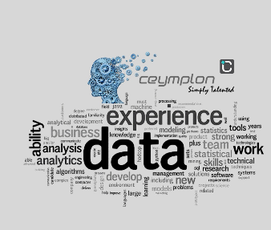
Industrial Training @ceymplon(Pvt)Ltd
Amalaseely Arulthasan
2015/sp/011

Slide 2
Contents
Company Profile
Training experience
Learning outcome
Conclusion

Slide 3
Company Profile
Ceymplon (Pvt) Ltd was founded as a subsidiary of jeylabs (Pty) Ltd in Sri Lanka in 2012.
Ceymplon team was expanded to Jaffna in 2014 with the establishment of the Northern Ceymplon IT Hub
One of the jeylabs Group of Companies and a pioneer software development and outsourcing company that has been providing solutions to businesses both nationally and internationally for the last ten years
They are determined and dedicated to solving the real-world problems of their customers through delivering branding solutions by using the best of technology, time-tested techniques, and trained and talented teams of passionate people.

Slide 4
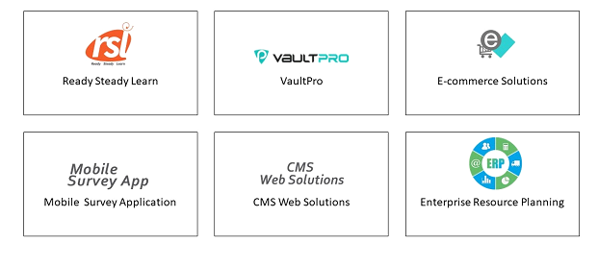
Ceymplon Products

Slide 5
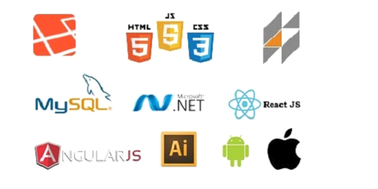
Technologies they use

Slide 6
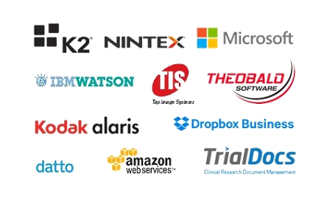
Ceymplon Partners

Slide 7

Clients

Slide 8
The projects I worked
Hierarchy team management System
Malaria Reporting System
Gis
Gantt Chart
Spell-out package
ReService
Micofin

Slide 9
ReService
Re-service is a booking application where service providers register their services them self and customize it according to their needs and features. This project structure follows a horizontally scaled server structure. So it can handle big loads easily
System key features
Providers can register and customize their services
Scheduler for both user and providers
Dashboard for user providers
Rating, comments for service providers
Recommending services by user’s search
Used Technologies
React, Amazon S3, Laravel, Material UI, MySQL

Slide 10
Micro-fin
Micro-fin is a finance application for small scaled finance companies. Specially designed for Loan officers who are collecting monthly dues from loan holders. This project has 2 major parts
1. Mobile application for loan officers
2. Admin panel for finance managers
System key features
Mobile Application | Admin Panel
get loan holders details for a particular GND | assign GNDs for loan officers
get full activities of a loan holder | Create loans and accounts
pay monthly due through mobile application | have control over time and location of loan officers
print bill | loan calculators

Slide 11
Gis
This is a project that Display the distribution of funds among various geological
sectors in Srilanka.This is a module of a government project
Module Key features
CRUD operations for activities, sectors, grama-niladhari
Display the distribution of money spend in a GND for various sectors in geological map
Display the distribution of money for particular sector among all GNDS all over Srilanka in geological map
used Technologies
Laravel-Nova
Leaflet JS(Open source map like Google map)
MySQL

Slide 12
Other two projects
Gantt Chart
Malaria Reporting System
Gantt chart is a module that interlink tasks and present it in a graphical view.
Module Key Features
Create tasks and subtasks
Assign subtasks to tasks
Used Technologies
Laravel-Nova
MySQL
Malaria reporting system is a system that stores malaria patient’s data from every hospitals and their treatment records and present as graphs and charts.
Module Key Features
​keep records of patients or suspect
​ ​produce graph and charts in different perspective
generating pdf

Slide 13
Used & Learned Technologies
Laravel
Laravel Nova
React
React Native
Javascript
Bootstrap
GitHub
Material-UI
Amazon Lex
Amazon S3
Leaflet(Open source map)
Bitbucket
MySQL
Ajax

Slide 14
Reflection & Learning outcomes
Team work
Punctuality
Communication skill
Self learning ability
Problem solving skill
Adaptability
Time Management
Positive thoughts

Slide 15
Conclusion
Objective of industrial training is to provide an opportunity to undergraduates to identify, observe and practice how computer science is applicable in the real industry.
It would enhance the students’ ability to think, learn independently and solve problems effectively and more importantly.
I could be able to get an awesome training program, which helped to learn a lot of things in all aspects.
I strongly agree on that it would be beneficial to every student to have this type of industrial exposure.

Slide 16
Thank You

Slide 17
Q & A

