Slide 1
Industrial Training at Mydynamica
Company profile
Company background
Technologies, product, project
Training Gained
Task
Transport system
Student management system
About Used technologies
Learning outcome
Conclusion
Sivanesan Menuja
2015/csc/041

Slide 2
Company Profile

Slide 3

Company Background
Founded by Yoheswaran yohaseelan in 2010.
CEO Rajenthiran vaheesan.
Using technologies are PHP, C#, Laravel, ASP.net, MYSQL, SQL server.

Slide 4
Project, product of the company
Products
Quicka Online Store (quicka.lk)
MYSCH School Blog (mysch.lk)
Smart School
CMS (colours web.site)
Red Banana (POS System)
E-Listing (elisting.info)
Yarl CCTV – Security Solution ( CCTV , Fingerprint System, Alarm System, Networking, Intercom, Computer Service & Repairs )
Projects
Management Systems –School, Pawing, Restaurant, Hotel, jewelry, institute, Transport, printing, Inventory, Hospitality, Exam, Studio.
Distribution Management System
Some other systems

Slide 5
Training Gained

Slide 6
Tasks
Transport System (individual project).
Student Marks Management System.
Data Entry of NIE, Puttur School, E-Listing.
NIE Documents Scanning and Cropping.
Learnt about software development and started from basic (java oop concept to laravel framework) through attend the our director’s class.

Slide 7
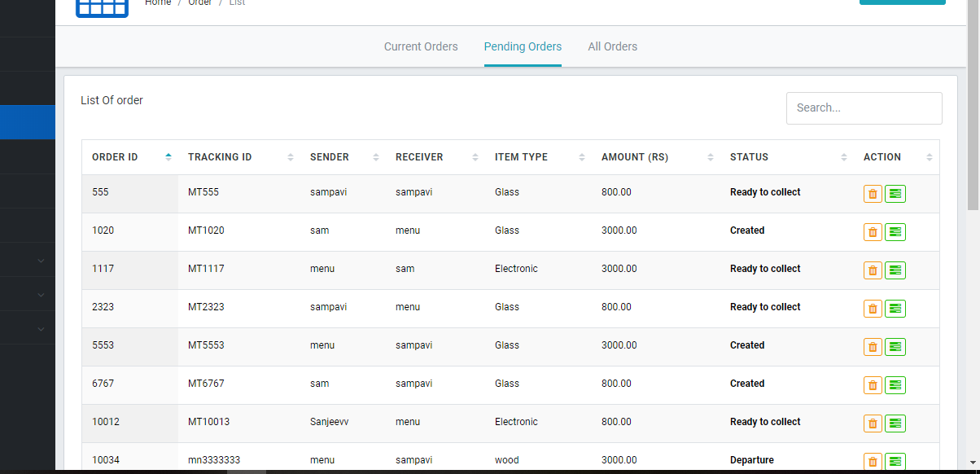
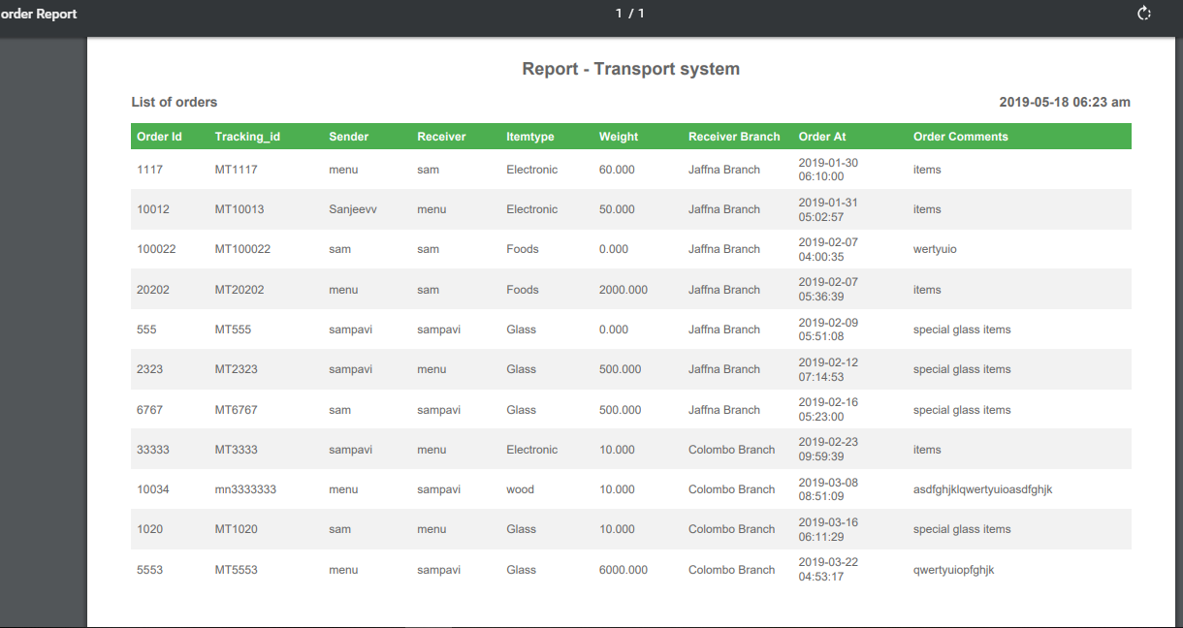
About Transport System
This is the web based system which used to maintain the parcel service details , create new items , give the alert message of status of orders to the branch, payments and billing system of that service. And also PDF excel format report downloading.

Slide 8
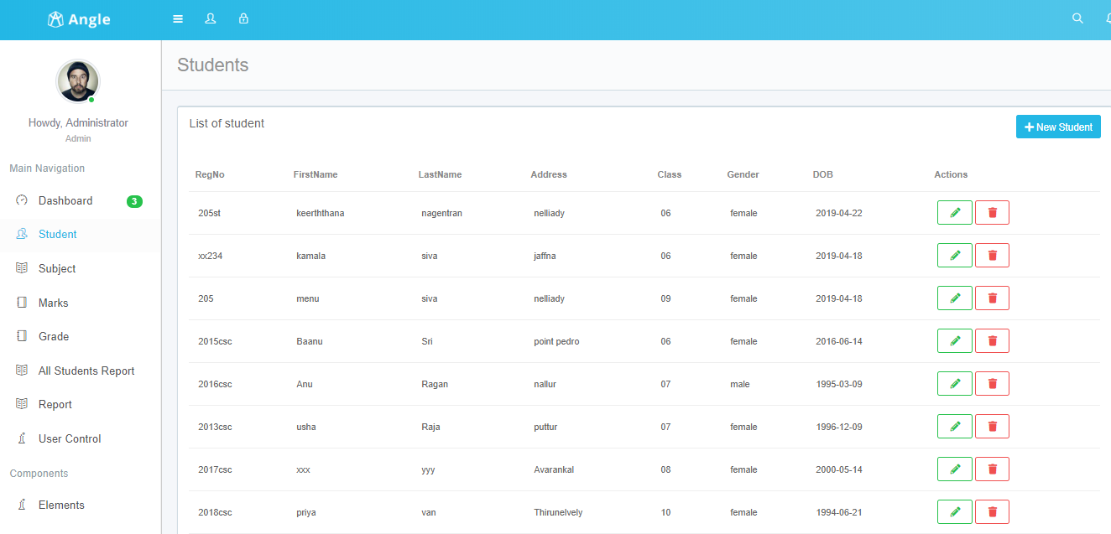
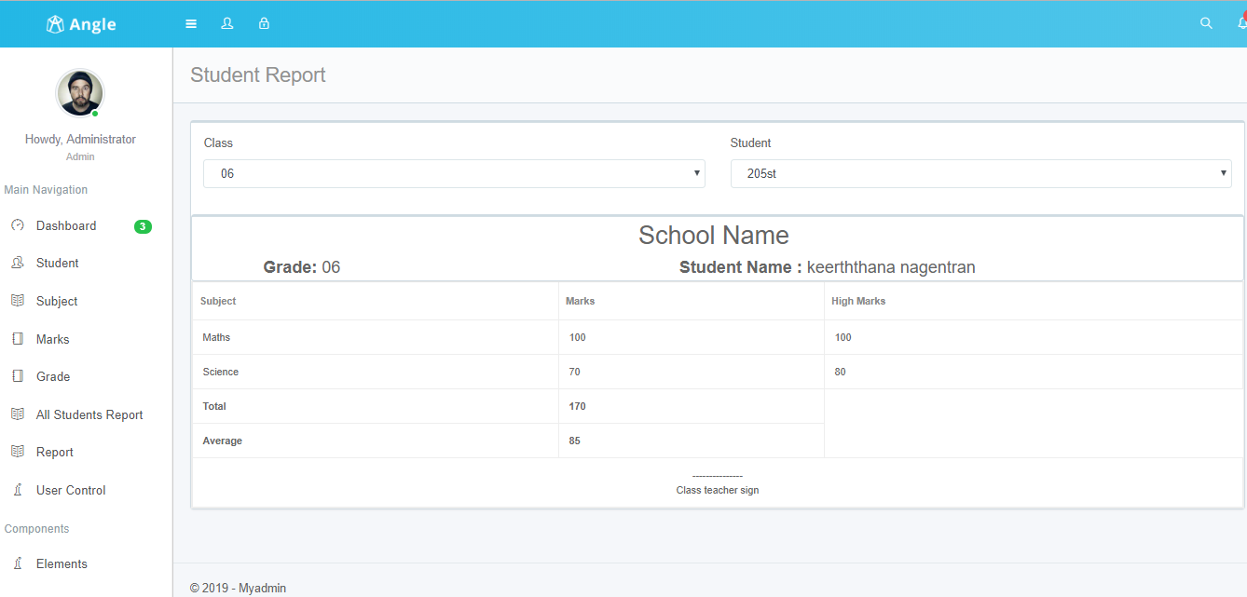
Tasks in Students Marks Management System
This is a desktop application which use to easily handle the students’ exam marks. In that project I did students, marks, subject, class CRUD(Create, Read, Update, Delete) function.

Slide 9
Used Technologies
After the training I was able to brush up my knowledge of some of technologies I already knew and I could study and improve my other technological skills.
Technologies – HTML, CSS, JavaScript, JQuery, Bootstrap ,PHP, MySQL, Laravel, wampserver.

Slide 10
Learning Outcome and Reflection

Slide 11
Learning Outcome and Reflection
Improved creativity and critical logical thinking .
Improved software development skills.
Identify my strength and weaknesses.
self management, self learning
self awareness, self motivation, self confidence.
Become updated with latest changes in technological world.
Improved my technological skills
team work
Information retrieval.

Slide 12
Conclusion

Slide 13
Conclusion
practical skills related to interpersonal, problem solving, research and as well as soft skill are improved.
provide an opportunity to undergraduates to identify, observe and practice how engineering is applicable in the real industrial world.
Highly beneficial for career guidance and is able to be fully immersed in what it means to be a software developer.
enables further to expand their creativity while seizing the profession ethical values as basis to venture into professional career in the future

Slide 14
Thank You

