Slide 1
Industrial Training
Airport & Aviation Services (SL) Ltd
J.B.K.Sandamali Pathirana
2015csc039

Slide 2

About Company
Fully Government own company.
Early 2010, IT section was converted to IT division by combining another section called Micro Section.

Slide 3
Projects
1.News Feed Management System
2.Squid Caching Proxy With Quota Management

Slide 4
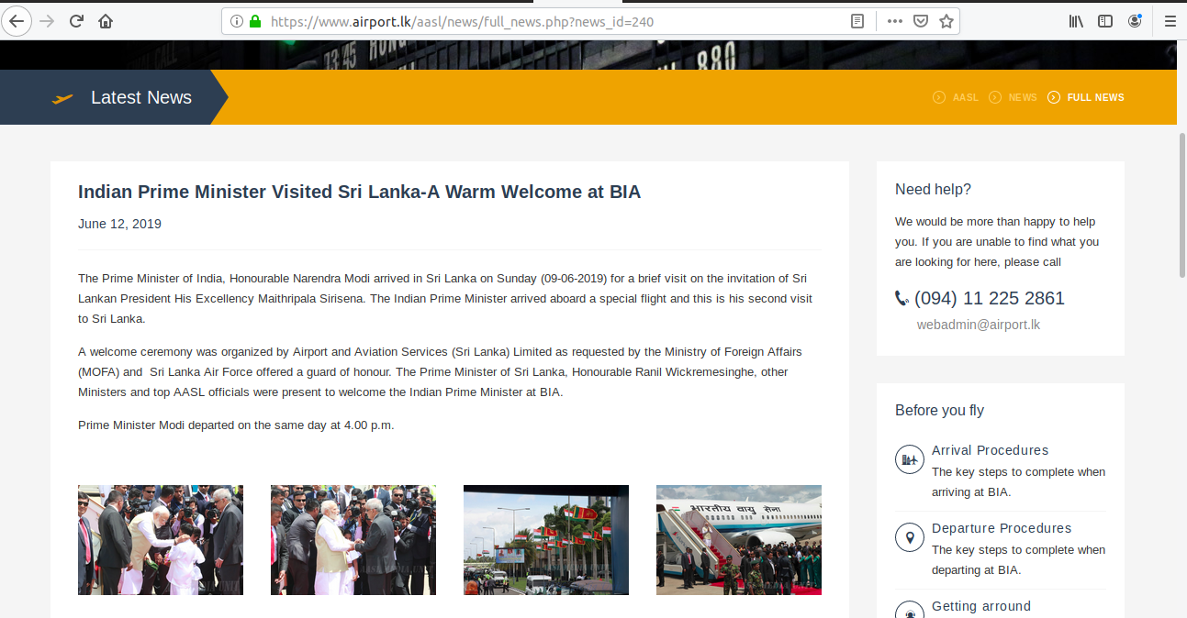
1.News Feed Management System
The News Feed Management System provides users to update the latest news about islandwide and international airport transportation operate in Bandaranaike International Airport.

Slide 5
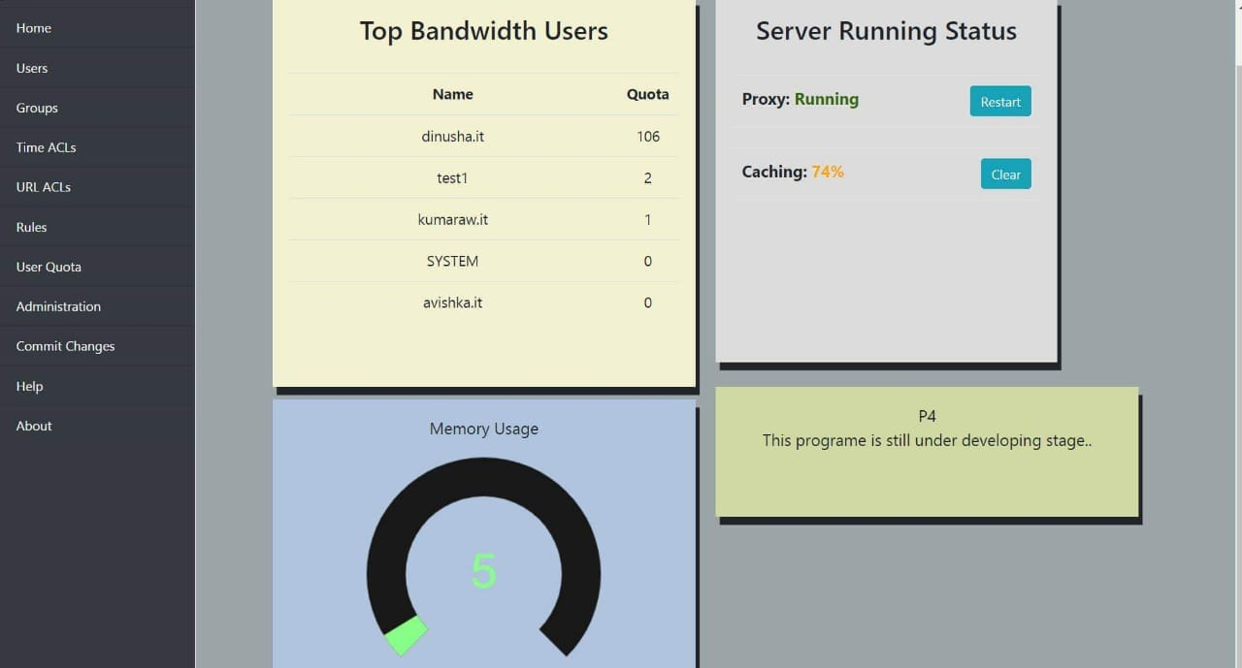
2.Squid Caching Proxy With Quota Management
Admin and authorized people can access statistical data such as Top Users, Quota Usage per User , Memory usage on the systems with login and time based url block. Other than those there are some capability for restart proxy, Display the cache percentage, clear the
cache and manipulate users on
the database and group users to
provide limited surfs.

Slide 6





Technologies
Php
sql(Mysql,MariaDB)
Html
CSS
Bootstrap
Javascript
Brackets
Python
VMware WorkStation
Bash Script

Slide 7
Experience
New Programing Techniques
Time Management
Company Management Process
Interact with different level of company members

Slide 8

Learning Outcome
New Programing Language
Programing techniques
Designing techniques

Slide 9

Problems and Difficulties
Unfamiliar Programing Language
Unfamiliar Techniques
Took Time To Adapt to The Environment
Unexpected Modifications

Slide 10


