Slide 1
Industrial Training at MyDynamica presented by Theevika Arumaiththurai 2015/CSC/035

Slide 2
Outline
Company Background
Training gained
Learning outcome
Conclusion

Slide 3
Company Background

Slide 4
Introduction to MyDynaica
Website solution and Software solution provider
Vision is recognized as Northern Province's leading IT Solutions Company
Founded at 2010
CEO is Mr.Rajendiram vakeesan

Slide 5
Products
Quicka Online Store (quicka.lk)
MYSCH School Blog (mysch.lk)
Smart School
CMS (coloursweb.site)
Red Banana (POS System)
E-Listing (elisting.info)
Yarl CCTV – Security Solution

Slide 6
Training gained

Slide 7
Tasks assigned
Testing the billing system of lovely flower center
user manual of Colombo restaurant
data entry of National Institute of Education management and Puttur school management systems
Dashboard of crc student management
Individual Project(meddyoli)

Slide 8
Meddyoli
Meddyoli is a matrimonial website
Objective is to provide groom and bride with excellent matchmaking experience by exploring the opportunities and resources to meet potential partner
User can get information regarding their dream life partner at his/her home at his/her convenience
Meddyoli will allow a new user to register and after approval user can get email confirmation and his/her profile will be visible to other users
Website link is http://meddyoli.com

Slide 9
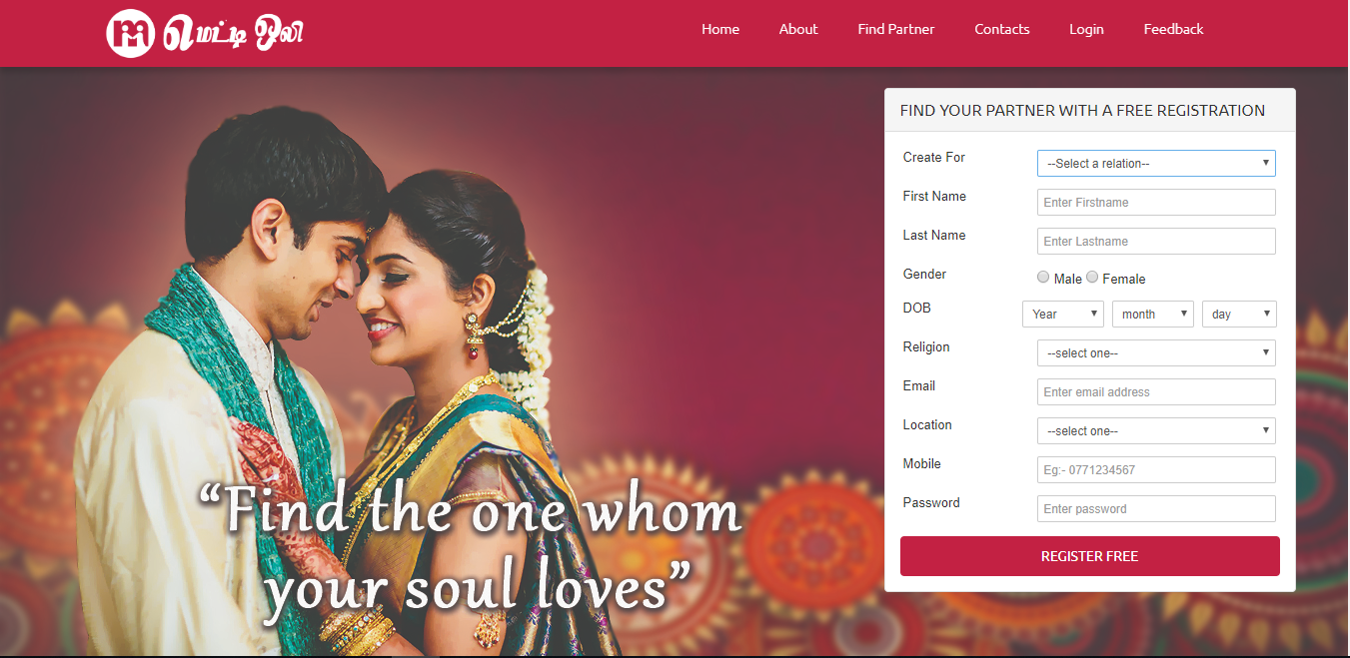
meddyoli website

Slide 10
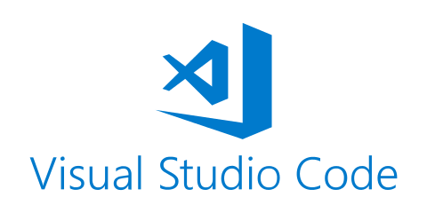
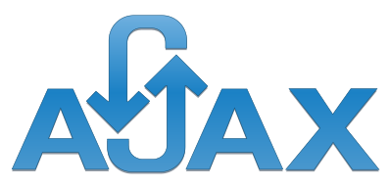
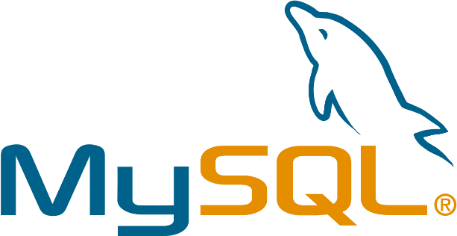
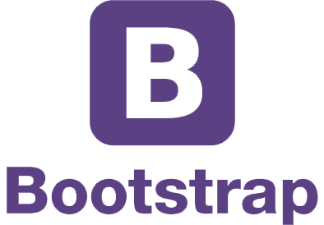
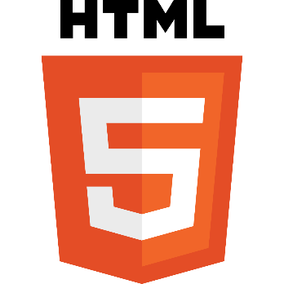
Technologies used

Slide 11
Learning outcome

Slide 12
Technical
Laravel,php,html,css,bootstrap,javascript,jquery,ajax and java
Mailing
Image upload & resizing
Excel export
Pdf conversion
Software testing
Database designing
UI Designing
Coding skill
Familiar with meister task and google sheets
Template integration
Virtual hosting

Slide 13
Non-technical
Stress tolerance
Self-management
Information retrieval
Adaptability
Self-awareness
Self-confidence
punctuality

Slide 14
Conclusion

Slide 15
conclusion
This training is to provide an opportunity to undergraduates to identify, observe and practice how engineering is applicable in the real industry
MyDynamica gave an awesome training program, which helped to learn a lot of things in all aspects
I strongly agree on that it would be beneficial to every student to have this type of industrial exposure

Slide 16
Thank You

