Slide 1
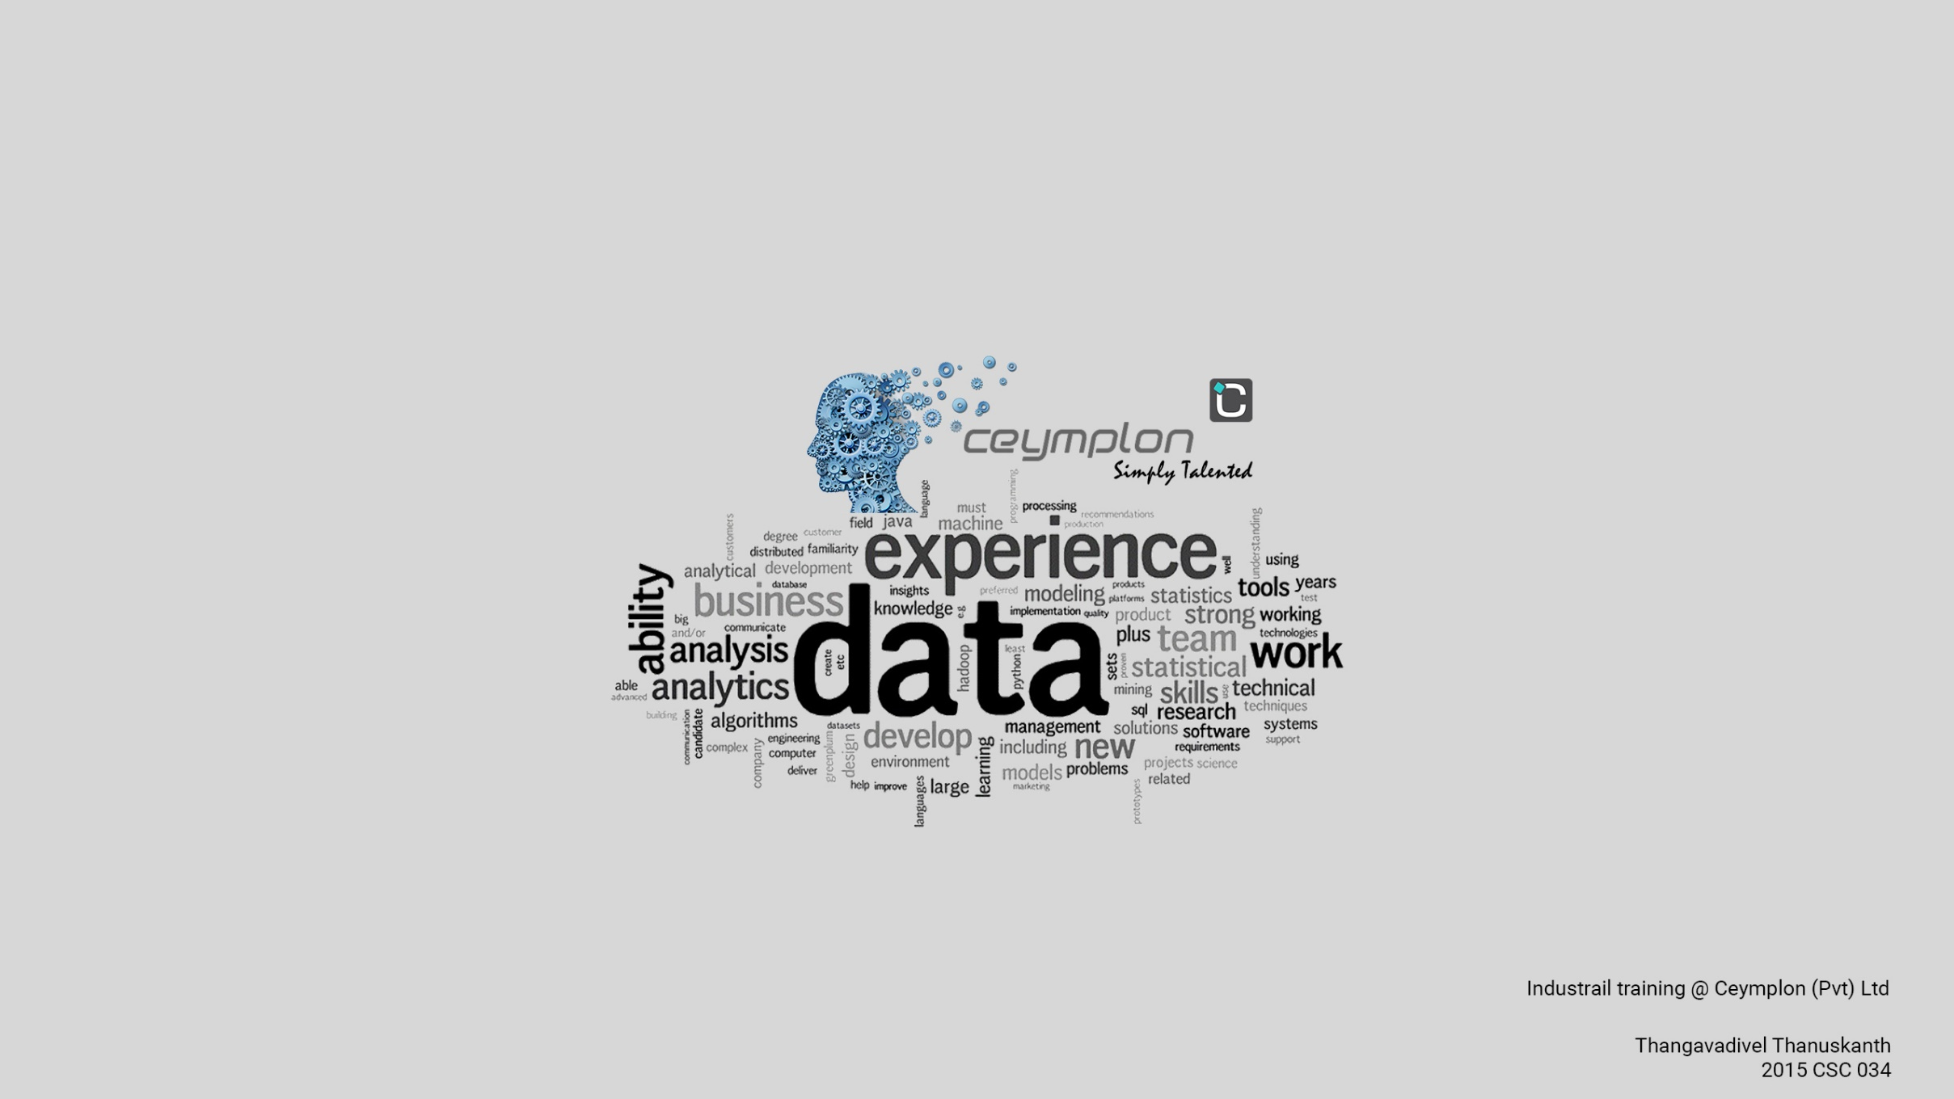

Slide 2

Company profile
Ceymplon (PVT) Ltd was founded as a subsidiary of Jeylabs (Pvt) Ltd in Sri Lanka in 2012.
Ceymplon team was expanded to Jaffna in 2014 with the establishment of the Northern Ceymplon IT Hub.
The first software company to set up a full-fledged software development team in Jaffna.
They are determined and dedicated to solving the real-world problems of their customers through delivering branding solutions by using the best of technology, time-tested techniques, and trained and talented teams of passionate people.
In provision of our services, they have assisted the governmental, non-governmental and community-based organizations immensely.

Slide 3
Products and Services
Ready Steady Learn (RSL)
VaultPro
E-commerce Solutions
Mobile Survey Application
CMS Web Solutions
Enterprise Resource Planning (ERP)
Various other products.

Slide 4

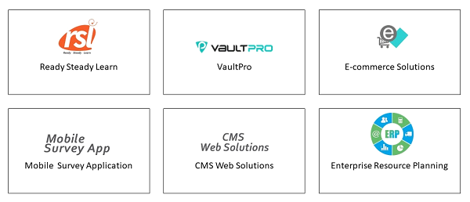
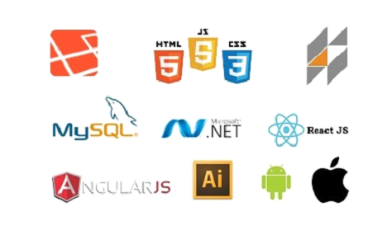
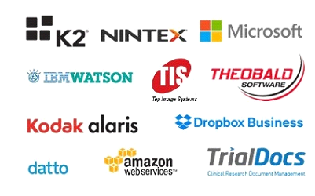
Products & Services
Clients
Technologies
Partners

Slide 5
The projects I worked
Hierarchy team management system
Malaria reporting system
GIS
Gantt chart
Re-Service
Micro-fin

Slide 6
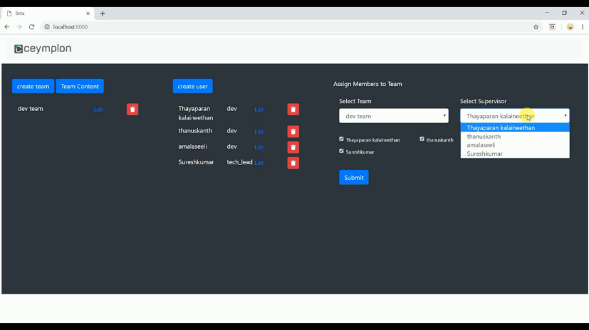
Hierarchy team management system
Framework used: laravel 5.7, Bootstrap . Database : MySQL.
  System key features
    Create a new team
    Create members
    can assign members to team
    assign supervisor to team from members
    change supervisor to the team
    cannot delete a member if he is assigned as supervisor to a team

Slide 7
Malaria reporting system
I used laravel nova frame work and MySQL database.
  System key features
    Keeps records of patients or suspect
    Produce graph and charts in different perspective
    Generating pdf

Slide 8
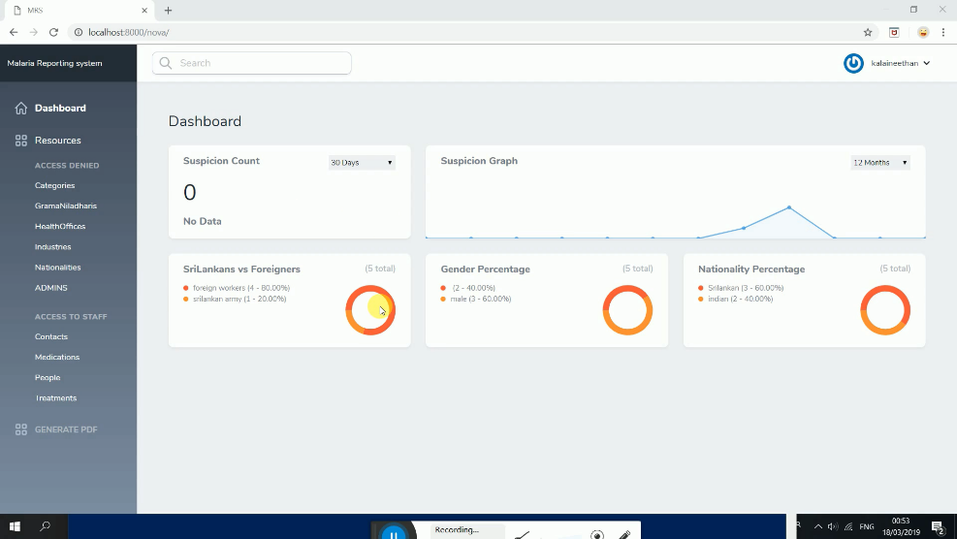
GIS
This is a project that display the distribution of funds among various geological sectors in Sri Lanka. Here I used laravel nova, Leaflet JS (open source map like google map) and MySQL 8.0.
  key features
    CRUD operations for activities, sectors, grama-niladharis
    Display the distribution of money spend in a GND for various sectors in geological map
    Display the distribution of money for particular sector among all GNDS all over Sri Lanka in geological map

Slide 9
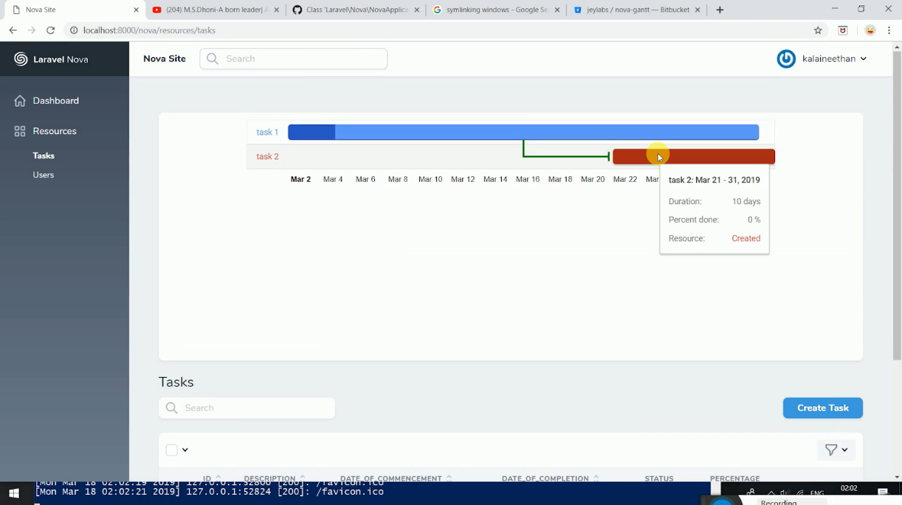
Gantt chart
Gantt chart is a module that interlink tasks and present it in a graphical view. I used Laravel Nova and MySQL.
  key features
    Create tasks and subtasks
    Assign subtasks

Slide 10
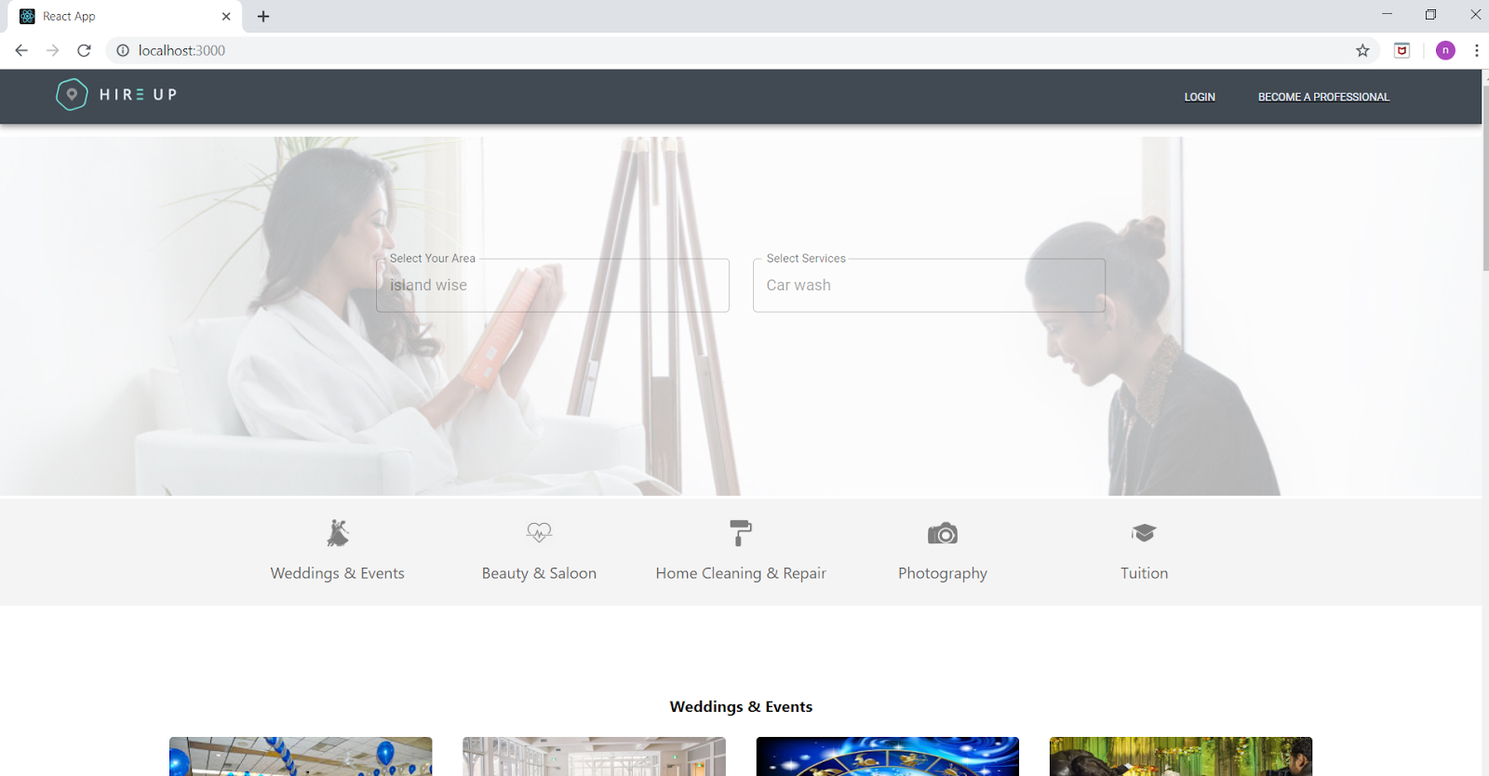
Re-Service
Re-service is a booking application where service providers register their services them self.
Customize it according to their needs and features.
This project structure follows a horizontally scaled server structure.
It can handle big loads easily.

Slide 11
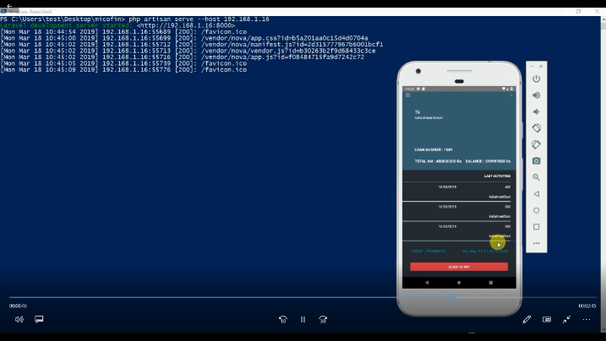
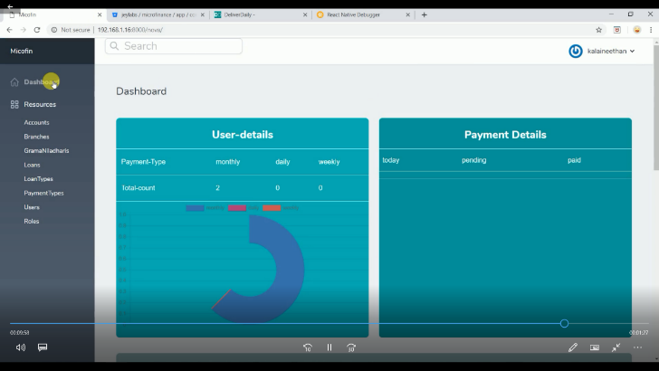
Micro-fin
Micro-fin is a finance application for small scaled finance companies. Specially designed for loan offers who are collecting monthly due from loan holders. This project has 2 major parts.
Mobile application for loan offers.
Amin panel for finance managers.

Slide 12
Used & learned Technologies
Laravel
Laravel Nova
React
React native
Material-UI
Bootstrap
Amazon Lex
Amazon s3
Leaflet – Open source map
Bit Bucket
MySQL

Slide 13
Reflection and learning outcome
Time management
Leadership
Communication
Problem solving skills
Improved self-motivation
Self learning abilities
Team work
Punctuality

Slide 14
Thankyou…

