Slide 1
Industrial Training Report
V.M.B Rasnakawewa
2015/CSC/025

Slide 2
Company Profile
Company Name : BlockchainAI (Pvt) Ltd
Company Address : BlockchainAI (Pvt) Ltd, Indra Rd, Dehiwala-Mount Lavinia, Sri Lanaka
Telephone Number: +94 77 117 7908
BlockchainAI (Pvt) Ltd is a company in Sri Lanka that's specializing in the growing fields of Blockchain and Artificial Intelligence technologies. It`s main objective is to integrate these technologies to businesses of all levels improving convenience and consistency. BlockchainAI is newly started company that have 12 members of staff.

Slide 3
Projects Worked On
Project 1 - Journal type web application developed by using Angular 7.
Project 2 – Spring boot rest API for a game.

Slide 4
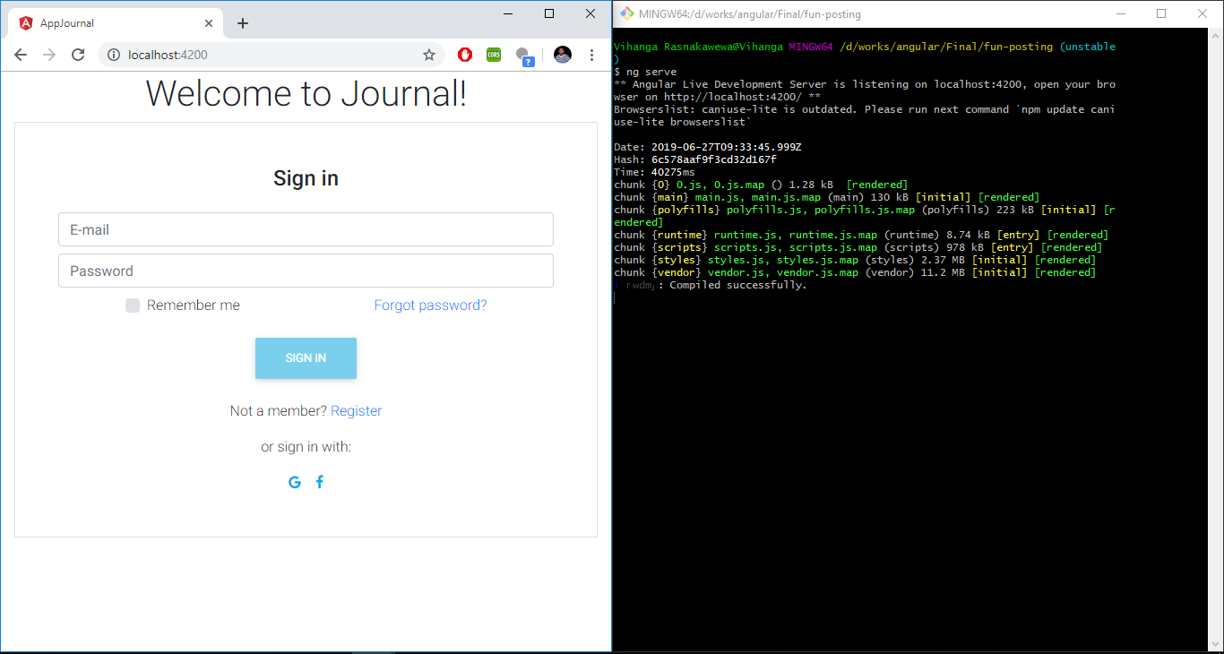
Journal
This is a journal type web project which we can create profiles and share articles to the journal and also can share those articles to social media.
Angular 7,Firebase

Slide 5
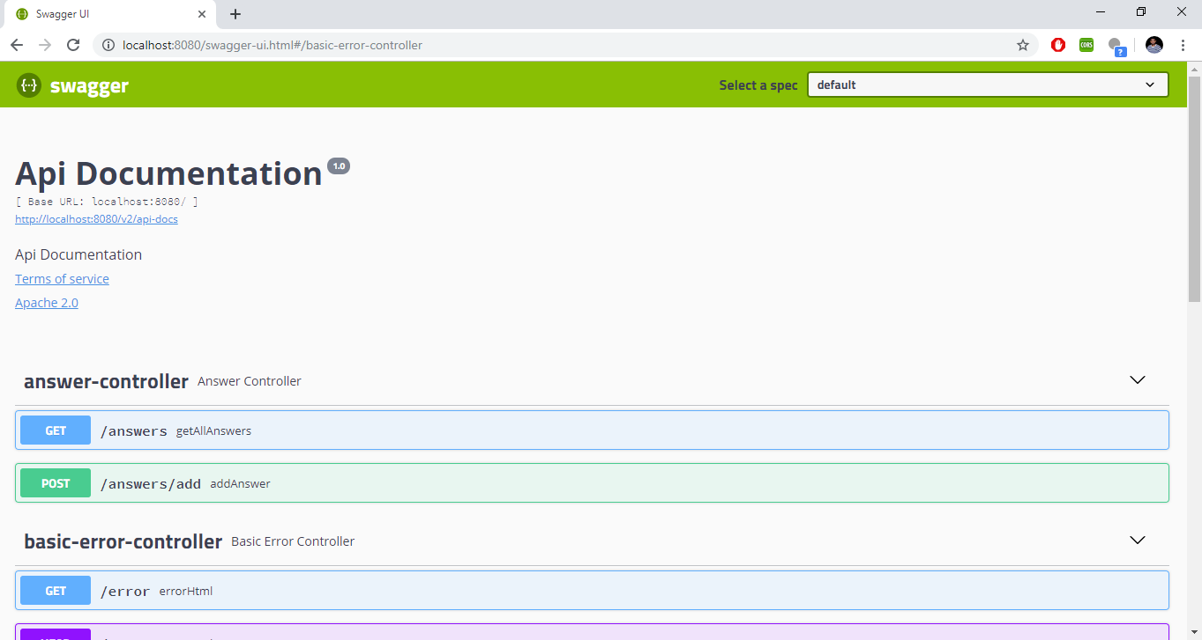
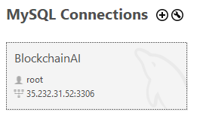
API
This is a spring-boot rest API for a game.
MySQL Workbench 8.0
Integrated Swagger-UI with the API.

Slide 6
Challenges Faced & Solutions Discovered
Had to upload videos to Youtube from Journal.Used Youtube Data API.With the YouTube Data API, We can add a variety of YouTube features to our application.

Slide 7
Thank You!

