Slide 1
Industrial Training at WSO2
Presented By:
Ajaya Karki
2015/CSC/FS/040
In partial fulfillment of requirements for the course unit
CSC319SC8
Period of training: 19/11/2018-19/06/2019
Presented on: 28th June 2019

Slide 2
Introduction to WSO2
Founded in August, 2005 by Sanjeewa Weerawarana and Paul Fermantile
Open source technology provider
CEO is Tyler Jewell
More than 500 employ including all the branches
Headquarter in Mountain View, California, United States.
Bulk of its research and operations are conducted from its main branch office in Colombo.

Slide 3
Products of WSO2
API Manager
Enterprise Integrator
Identity Server
Stream Processor
WSO2 Cloud
Ballerina

Slide 4
Products I worked with
WSO2 Enterprise Integrator (WSO2 EI)
Siddhi (Query Language)

Slide 5
Projects and Tasks completed
Amazon Lambda Connector for WSO2 EI
Benchmarking Siddhi Query Language
Refactoring Siddhi Extension to sync up with latest version change
  Siddhi-execution-geo
  Siddhi-io-twitter
  Siddhi-execution-map etc.
Refactoring Siddhi Extension for Repo move.

Slide 6
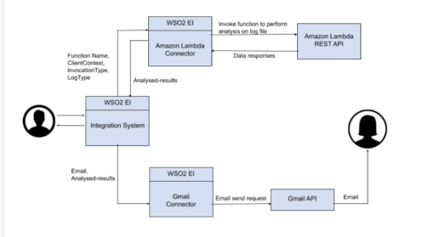
Workflow of Amazon Lambda Connector using WSO2EI

Slide 7
Languages and Framework Used
Java
XML
JavaScript
Maven (Building tool)
JMH for Benchmarking
GIT (Version Control System)

Slide 8
Problem Faced
Faced problem on speeding up the pace of project due to lack of experience
Debugging quickly
In-project problem like finding source of error
Communicating with team and mentor
But later on improved everything with help of friendly environment of WSO2 and friendly and supportive mentor and leads

Slide 9
Learning Outcome and Reflection
Improved communication skills along with coding skills
Improved team working capability
Adaptability
Improved technical knowledge as I had to learn multiple languages and framework for one project.
Self-confidence and self management

Slide 10
Conclusion
Highly support Internship training as an academic part as it provides opportunity for an undergraduate to learn about their working field, create link with professionals in their field and teach them how to apply what they have learned in University
Enables to Improve creativity while providing the broader knowledge for their career guidance
Helps to Improve technical knowledge along with other soft skills

Slide 11
Reference
https://en.wikipedia.org/wiki/WSO2

