Slide 1

Training @ mitra innovation
Justus Nithushan
2015 CSC 032

Slide 2

COMPANY PROFILE
Started in 2012 by Mr. Ashok Suppiah, Mr. Darek Bell and Mr. Dammika Ganegama
Focus on digital transformation, cloud enablement, and software development for ISVs, Enterprises and Entrepreneurs
Specialized in the services such as
WSO2 middleware
Cloud services such as AWS, Azure, GCP
Technology consulting
Software developments (including app development, bespoke software development, and platform and product incubation)

Slide 3
PROJECTS
Neural Style Transfer API creation
TerryWhite Demo Application
Praedictio-AWS
RM Tool

Slide 4
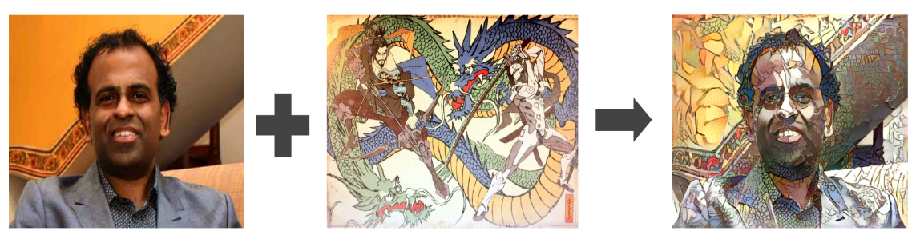
NEURAL STYLE TRANSFER API
Problems Faced -> Solutions found:
Slow output -> only for GPU instance
Making the programs to support GPU -> Used nvidia-docker tensorflow-GPU
Technologized used:
Python
Flask framework
AWS S3
AWS ECR
AWS sagemaker
AWS EC2
Docker
Neural Style Transfer is a technique that merges two images by adopting the pattern of one image (style image) to the other (content image)
How I achieved:
Wrote the inference code and created an endpoint using python.
Dockerized it and uploaded the docker image to AWS ECR
Validated/packaged the model in AWS sagemaker
Published the model in AWS marketplace

Slide 5
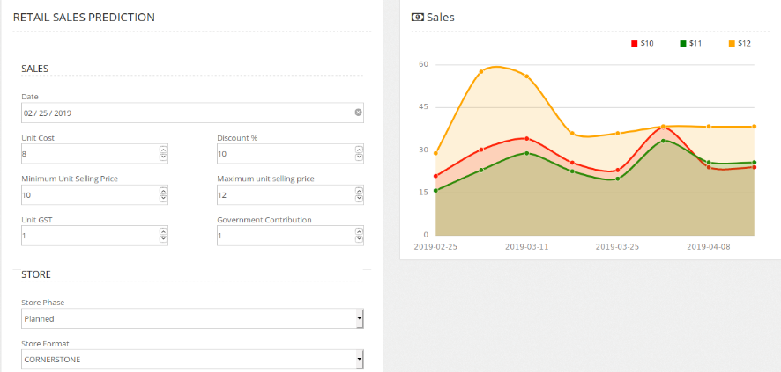
TerryWhite demo application
A web application to visualize the prediction results of a sales prediction machine learning model
What I Did:
Did the complete back-end and front-end
Created UI for parameter selection and UI for endpoint configuration
Created backend functionalities to call the API with the specified parameters using node.js
Displayed the output in a graph with three separate lines each indicating different output for different prices, to get an optimized price
Displayed the gross profit in a separate graph for each price
Created all the CRUD functionalities for endpoint configuration page
Technologized used:
Node.js
Morris.js
Bootstrap
Jquery
Problems Faced -> Solutions found:
When changing each model I got only very little time to change the UI and API call ->
Worked overtime and worked at home and delivered the product each time without a delay

Slide 6
Elastic search for praedictio
Searching part of a data-lake application called praedicto-aws project
How I Achived:
Dockerized the elastic search engine and pushed it to docker hub.
Added the functionality in CFT to pull the docker image in the docker hub and kept it in EC2 instance.
Developed lambda script to index documents that are put inside the data-lake S3 bucket.
Copied the lambda script and had it in the base AMI which had all the prerequisites to run the application.
Added functions in CFT to copy the lambda function which was in the AMI into an S3 bucket.
Added functions in CFT to start the lambda service corresponding to the lambda script.
Added functions to run the docker image which was pulled and kept in EC2 instance, using an executable file which was then placed in the base AMI.
Added the public IP of the EC2 instance in an environment variable to use it in the web app.
Added node.js function to search documents using the elasticsearch search api.
Added the javascript functions to call the search function with required parameter values.
Technologized used:
Elastic Search
Docker
AWS lambda
AWS Cloud-formation
AWS S3
AWS EC2
Bootstrap
Node.js
Problems Faced -> Solutions found:
Had some issue with local setup - >Did everything
in Cloud

Slide 7
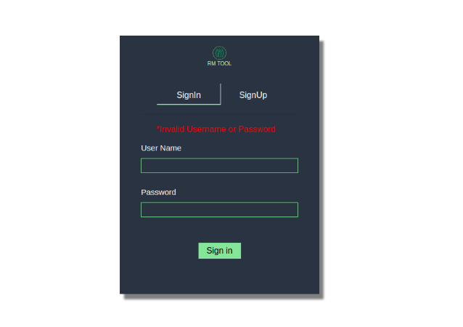
RM Tool
Resource management tool (a web application) to make the allocation of resources efficient.
What I did:
Overall layout template of the project using react.js
Developed user interface for sign-in and signup for admin users.
Created the user management page
Completed the google authentication (restricting the domain to mitrai.com) with the help of the other team members
database connection and database helper functions
Created user management backend functionalities
Technologized used:
Node. js
React.js
Mongo Db
Bootstrap

Slide 8
Learning Outcome
Hands-on with some latest technologies
Confidence in taking responsibility
Time management
Leadership skills
Communication
Problem solving skills
Self learning abilities

Slide 9
Thank you

