Slide 1
Industrial Training at
r.m.p.l.b.Rathnayake (2015/CSC/030)

Slide 2
About Softknowedge
Softknowedge is an IT Company which was founded in 2010.
Softknowedge specialize in the development of ERP solutions for manufacturing organizations and custom software applications.
Softknowedge carries out custom programming, database design, and client-server and internet/intranet software application development.

Slide 3
Company Services
ERP Implementations
Small Business Application implementations
Customized Software Development
Web site Designing and Development
Mobile Application Development
Business Process Re-Engineering
Software Consultancy
Networking and Communication Solutions
Hardware Solutions

Slide 4
Company Products

Slide 5
Contributed Projects
BRACE web enterprise resource planning solution for manufacturing companies. This solution consists of merchandising inventory management, Planning work study, Production, Sampling, Shipping, Fixed assets management and accounts payable and can integrates to any finance system.

Slide 6
Contributed Projects
RAICE is an integrated solution that helps in managing the most valuable assets in the enterprise that is the employee. This has covered the whole cycle of human resources management starting from recruitment to post resigns. This solution is a fully web based solution.

Slide 7
Technologies
Codeigniter framework
Php
jQuery and Javascript
mysql
html
css
booTstrap

Slide 8
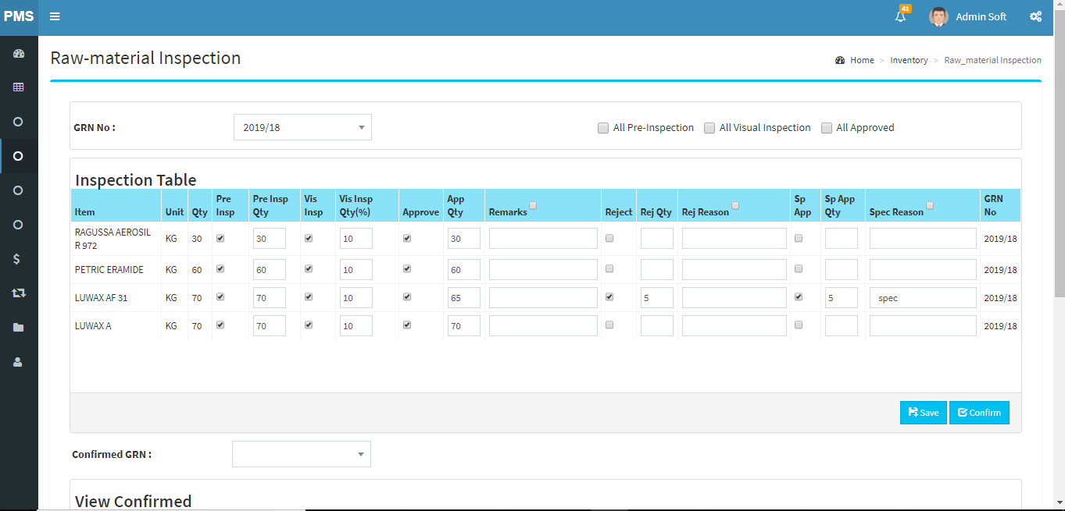
Some Works Carried out
1. Raw material Inspection.
Using this unit we put a record about inspected materials in a GRN(Good Received Note).

Slide 9
2. Order Approvals.
This is a dashboard item. This shows sales orders sent by the sales person. Then user can approve or reject the order after viewing the sample of sales order.

Slide 10
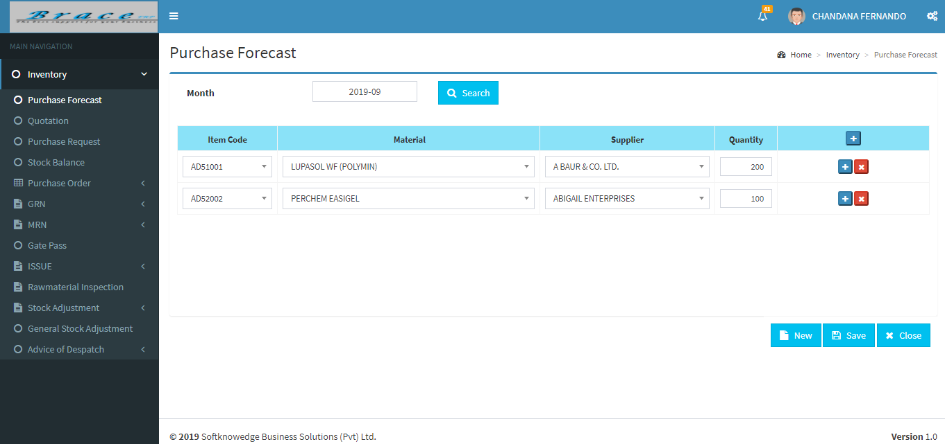
3. Purchase Forecast.
Here, the user creates a list of items that are to be bought from suppliers in the coming month. And then another user create quotations for those items.

Slide 11
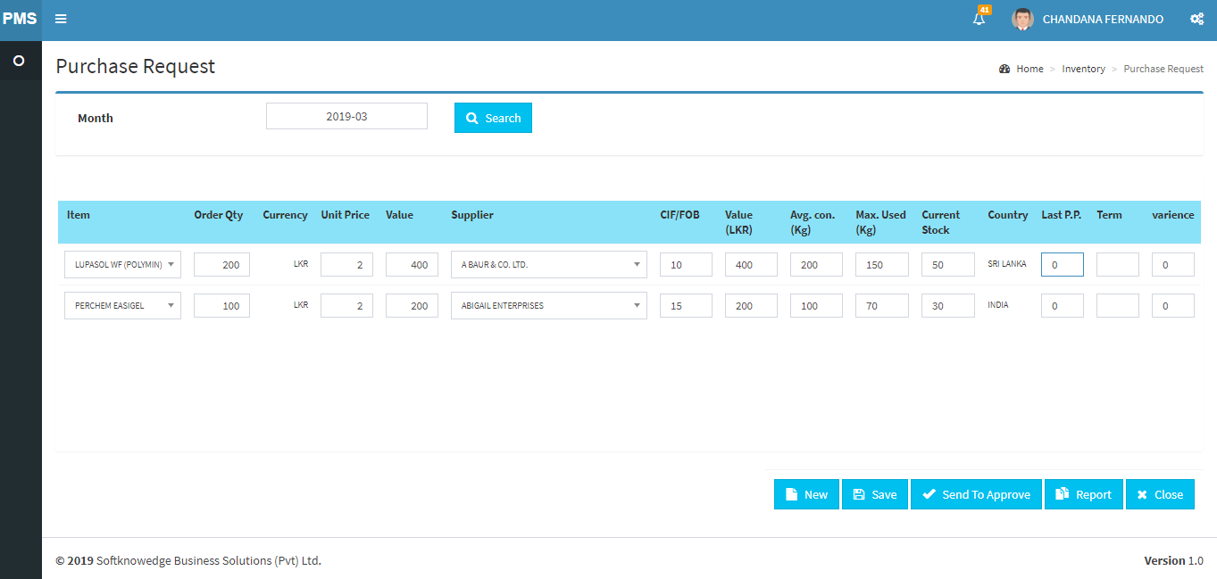
4. Purchase Request.
After putting quotations, those items are sent to purchase request. This is the final schedule of import items. Then this request is sent for the approval process.

Slide 12
Learning Outcome and Reflection
Improved creative, critical and logical thinking.
Improved coding skills.
Error checking and handling errors.
Stress tolerance.
Self-management.
Business process understanding.
Adaptability.
Team Spirit.
Experience with professionals.

Slide 13
Conclusion
Industrial Training provides an opportunity to an undergraduate to identify, observe and practice how engineering is applicable in the real industrial world.
Great opportunity to work with professionals and gain knowledge about industry.
Practical solving, research and reporting as well as soft skills are improved.
Enables to expand creativity while seizing the professional ethical values as basis to venture into professional career in the future.

Slide 14
Thank You.

