Slide 1
INDUSTRIAL TRAINING AT
MITRA INNOVATION
N.ANJALIN NIRUPA
2015CSC028

Slide 2
COMPANY BACKGROUND
Mr. Ashok Suppiah (CEO), Mr. Darek Bell (COO) and Mr. Dammika Ganegama (MD) founded this company in 2012.
Specialized in digital transformation, cloud enablement, and software development for ISVs.
Specialized in the services which includes WSO2 middleware, cloud services such as AWS, DevOps and managed services, and software developments (including app development, bespoke software development, and platform and product incubation)

Slide 3
PROJECTS
TECH REPOSITORY
PEOPLE HR SYSTEM
RESOURCE MANAGEMENT TOOL
TASKS
CALCULATOR
AUTOMATED EMAIL SENDING
TROUBLESHOOTING
FRONTEND & BACKEND

Slide 4
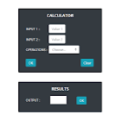
CALCULATOR
TECHNOLOGIES USED :-
Angular Js
CHALLENGES :-
First experience with Angular JS
Short time period.

Slide 5
AUTOMATED EMAIL SENDING
HR purpose
Used apps script
Did with triggering
Logs for output
CHALLENGES
New to Java script, apps script and some terms like triggering

Slide 6
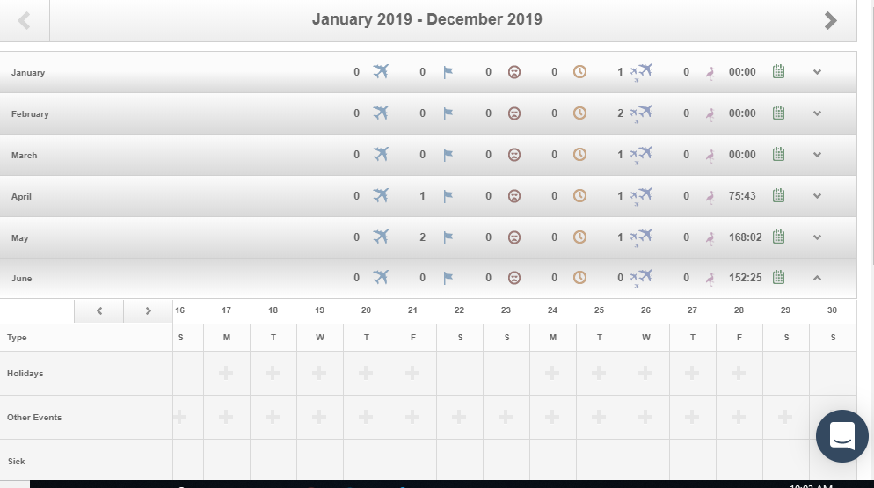
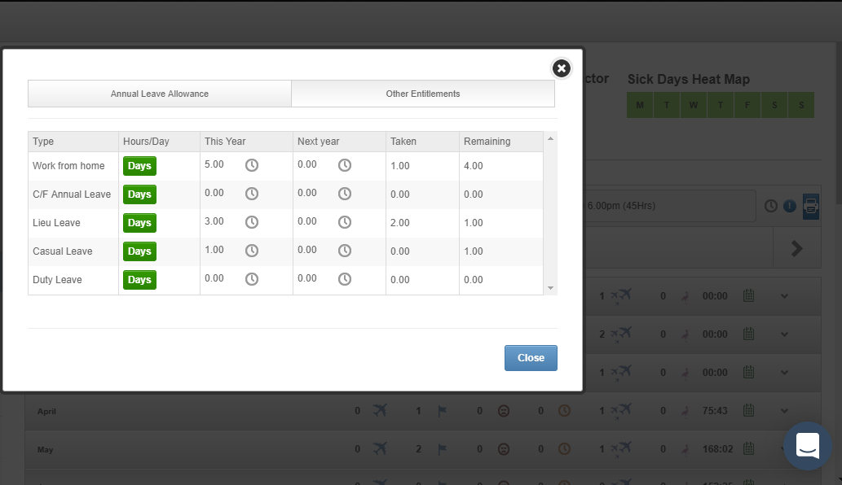
PEOPLE HR SYSTEM
Easily import or create employee records, and then customise them to perfection by adding own unique information screens.
Time & attendance, payroll and HRIS.
Holiday planning and absence management.

Slide 7
LEARNED :-
Webhooks. Cron job and Schedulers
TECHNOLOGIES USED :-
Spring boot
SQL server
CHALLENGES :-
Short time period to understand the code base.
New problems were arrived while troubleshooting.
Lack of guidance at the beginning.

Slide 8
RESEARCH AND DEVELOPMENT
Machine Learning.
Model for classification of handwritten alphabets.
Tutorials with blender app.
CHALLENGES :-
Lack of guidance.
Before completing I was assigned to another project.

Slide 9
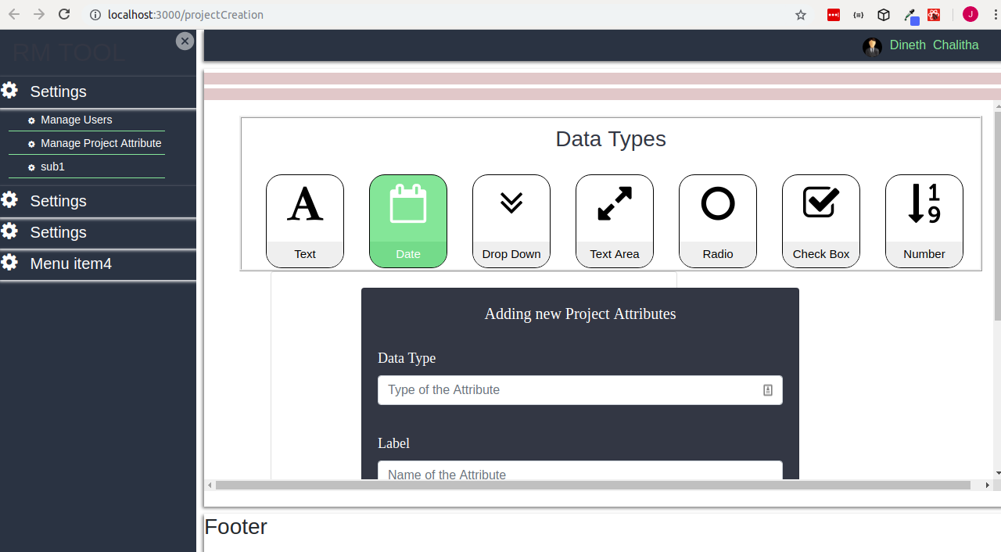
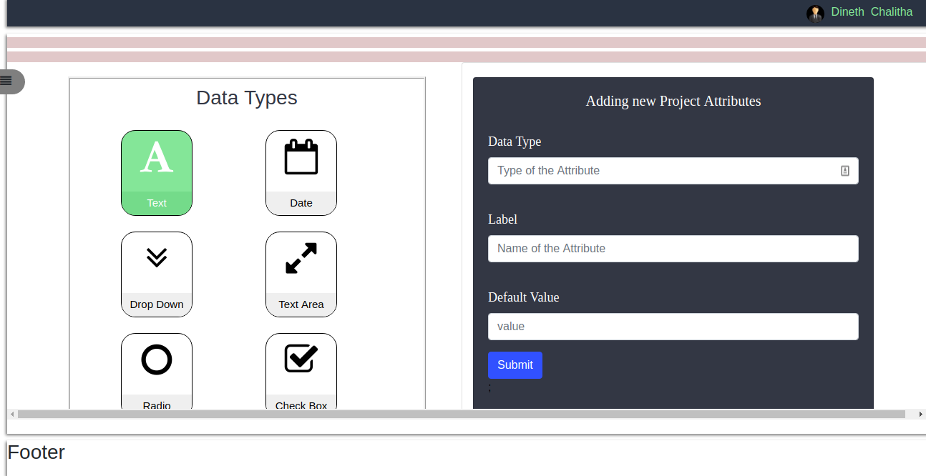
RESOURCE MANAGEMENT TOOL
Sign in through google authentication.
Allocating resources for the projects.
Did the attribute creation page.

Slide 10
TECHNOLOGIES USED :-
React JS
Node Js
MongoDB
CHALLENGES :-
New technologies.
Unclear and changing requirements.

Slide 11
Others :-
Daily Standups and spring meetings.
Clean coders session.
Tech talk on Git best practices.
Boot camp on React Js.

Slide 12
Learning Outcome
Learned some new technologies.
Developed some soft skills such as team work, problem solving and time management.
Got an idea about industry oriented side of software engineering.

Slide 13
WORKING ENVIRONMENT
Supportive colleagues.
Encouraging supervisors.
Multicultural environment.
Flexible working style.

Slide 14
THANK YOU

