Slide 1
Industrial Training at
bY A.D.T. Dilhara (2015/CSC/027)

Slide 2
Introduction to Softknowedge
Softknowedge is IT Company which was founded in 2010.
Softknowedge specialize in the development of ERP (Enterprise resource planning) solutions for manufacturing organizations and custom software applications.
Softknowedge carries out custom programming, database design, and client-server and internet/intranet software application development.

Slide 3
Company Services
ERP Implementations
Small Business Application implementations
Customized Software Development
Web site Designing and Development
Mobile Application Development
Business Process Re-Engineering
Software Consultancy
Networking and Communication Solutions
Hardware Solutions

Slide 4
Company Products

Slide 5
Clients

Slide 6
Contributed Projects
BRACE WEB enterprise resource planning solution for manufacturing companies. This solution consists of merchandising inventory management, Planning work study, Production, Sampling, Shipping, Fixed assets management and accounts payable and can integrates to any finance system.

Slide 7
Contributed Projects
RAICE is an integrated solution that helps in managing the most valuable assets in the enterprise that is the employee. This has covered the whole cycle of human resources management starting from recruitment to post resigns. This solution is a fully web based solution.

Slide 8
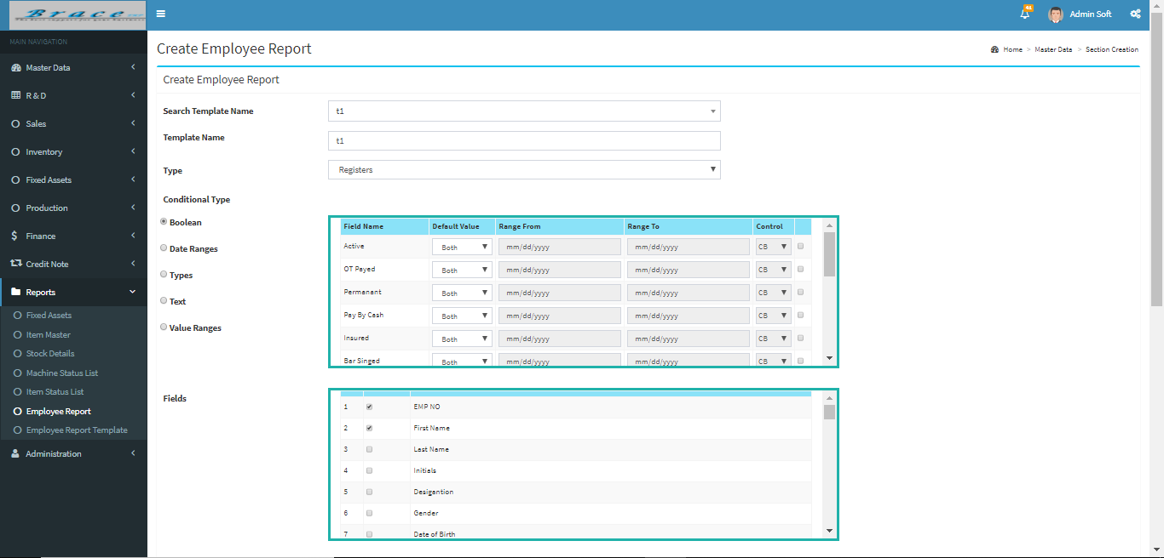
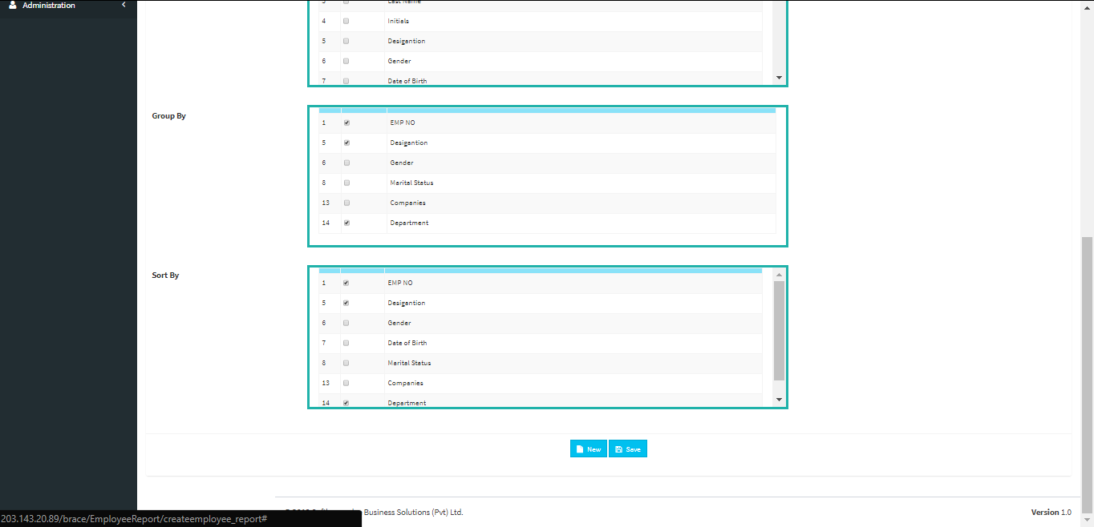
Work Carried out
1. Employee Report Template Creator
Using this unit we can create all report templates regard all of employees in the company.

Slide 9
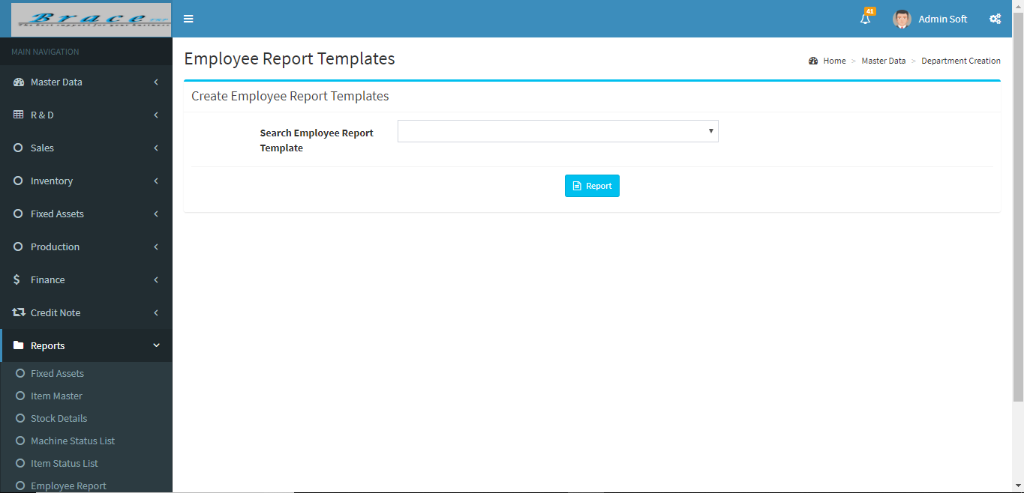
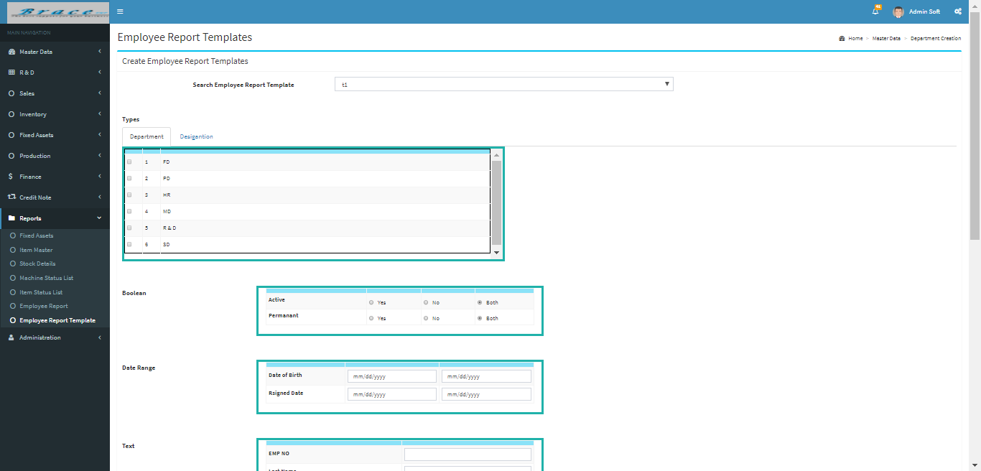
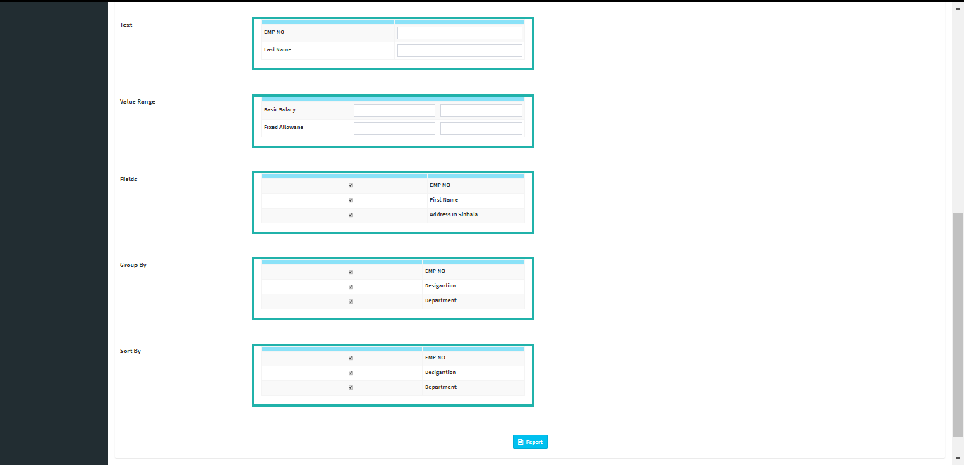
2. Employee Report Template Viewer
This viewer use to view employee report templates and get report.

Slide 10
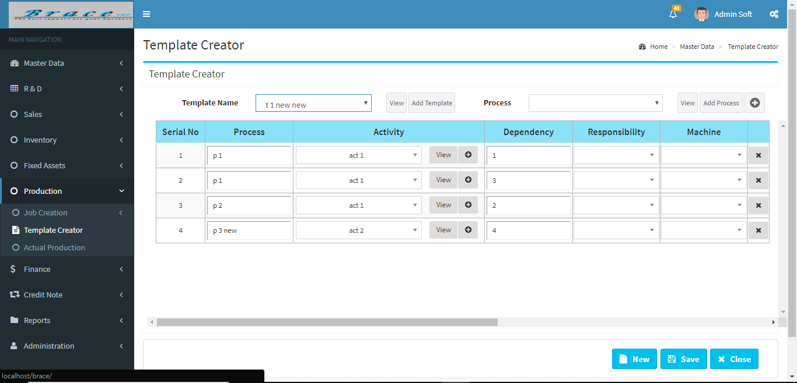
3. Job View
This is a dashboard item. This is show job status using color bars. Then user can get idea what are the status of jobs and how he react to them. All jobs and status of them get for data table and check status and map color bar for status number.
4. Template Creator
This is used to create template regard process and activity.

Slide 11
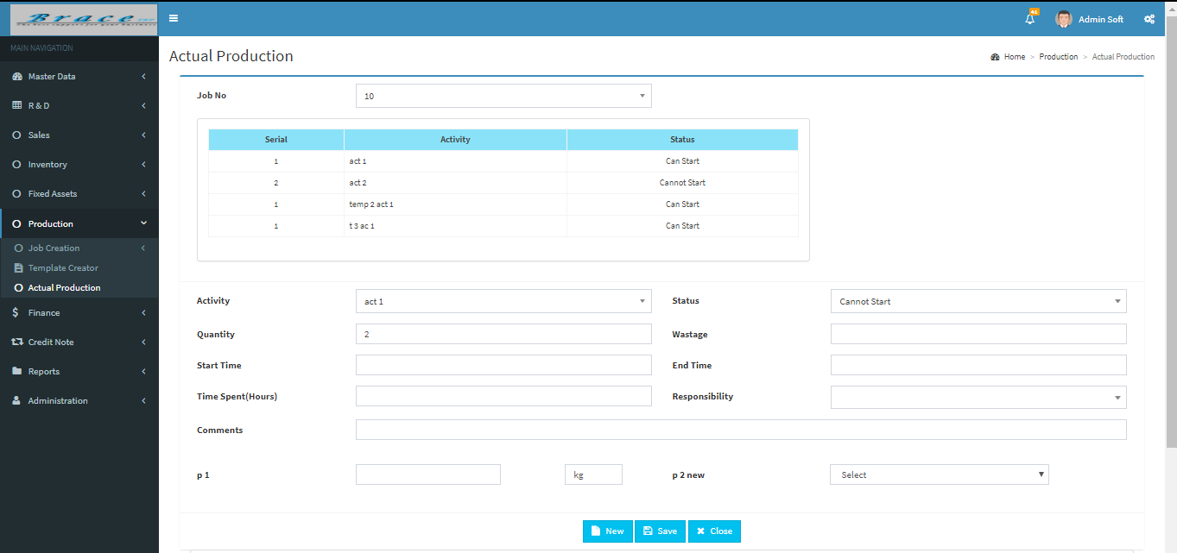
5. Actual Production
In here we can select Job number and we can see activities in the table. When click anywhere on the table we can see properties of related activity.

Slide 12
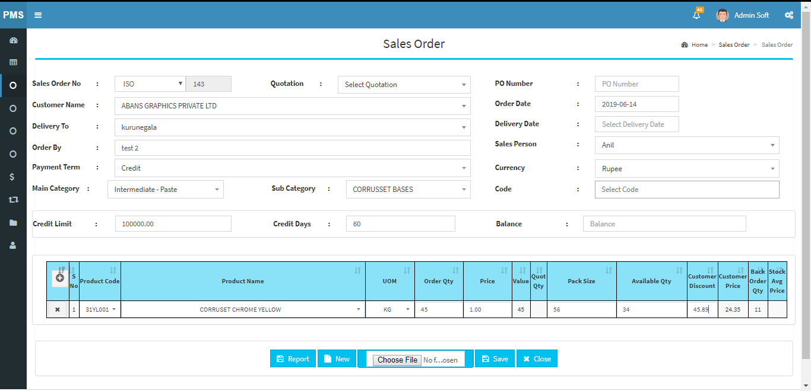
6. Sales Entry and Order Number
Sales entry is use to enter sales order details. Order number is use to view sales order

Slide 13
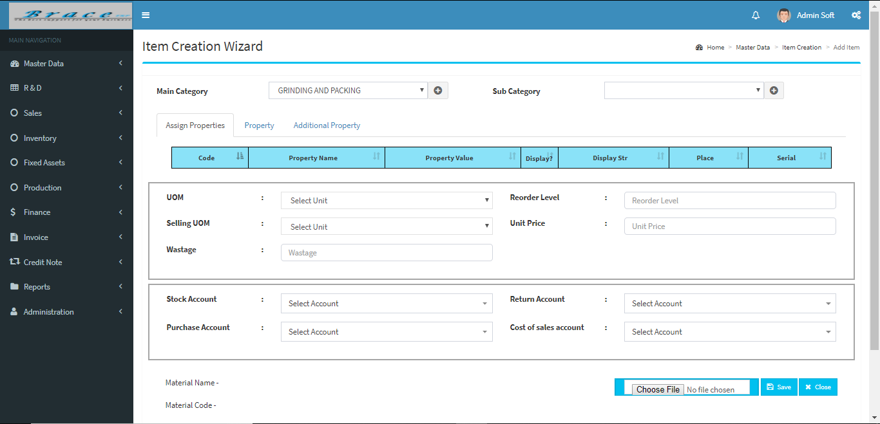
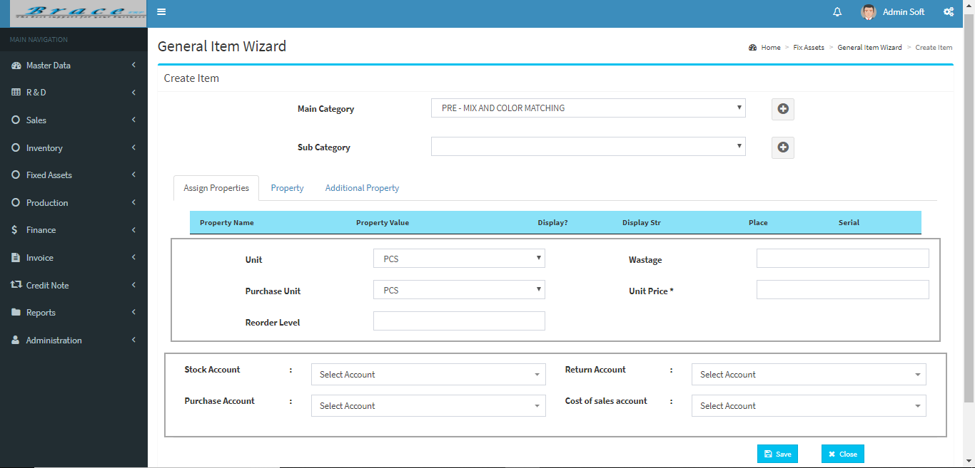
7. Item Creation Wizard and General Item Wizard
Item Creation Wizard use to add Row Material, its property and add its additional property.
General Item Wizard use to add new machine to system.
We can add its properties and additional properties.
8. Stock Balance
We can check stock balance available in the stores.

Slide 14
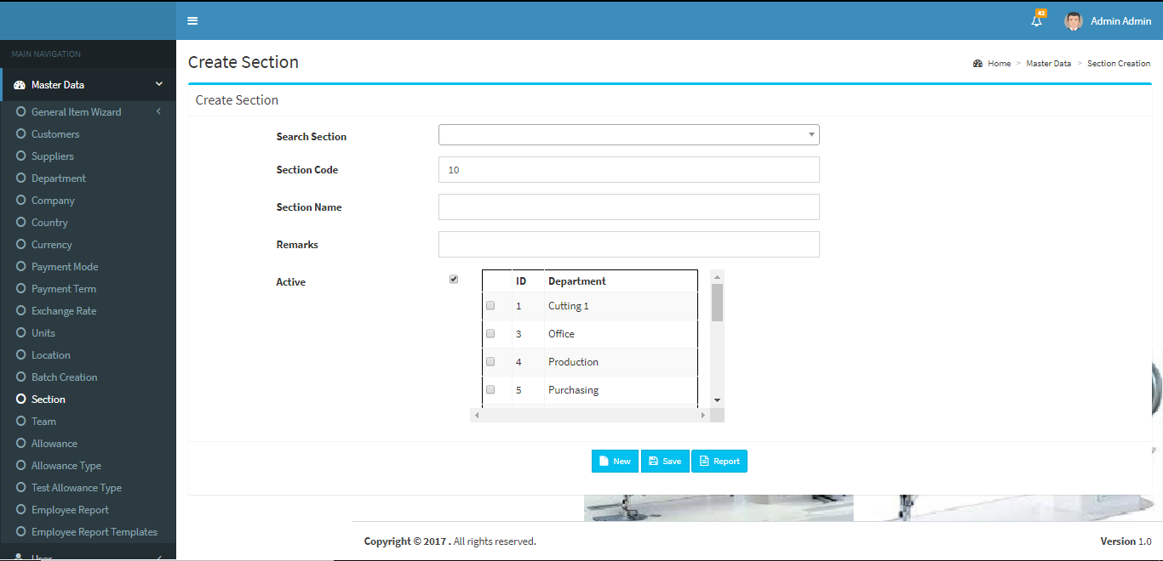
9. Create Section
This is use to create section under any department. This is created for RAISE project.

Slide 15
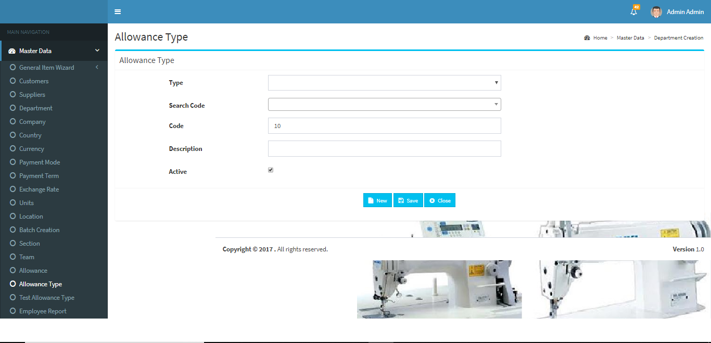
10. Allowance Type
This is use to create Allowance Type with description. This is created for RAISE project.

Slide 16
Technologies

Slide 17
Learning Outcome and Reflection
Improved creative, critical and logical thinking
Improved coding skills
Stress tolerance
Self-management
Adaptability
Improved Communication skills
Leadership
Team Spirit
Experience with professionals

Slide 18
Conclusion
Provides an opportunity to undergraduates to identify, observe and practice how engineering is applicable in the real industrial world.
Practical solving, research and reporting as well as soft skills are improved.
Enables to expand creativity while seizing the profession ethical values as basis to venture into professional career in the future.

Slide 19
Thank You

