Slide 1
Industrial Training at Softknowedge Business Solutions (Pvt) Ltd
Presented by – W.K.A.R. Walpola
2015/CSC/021

Slide 2
Introduction to the Organization
Name of the organization – Softknowedge Business Solutions (Pvt) Ltd
Chief Executive Officer – Mr. Nishantha Punchihewa
Products
Braze
Raise
GaPro
Main functionalities
Expert in providing ERP solutions
Customization and integration of complex enterprise-level solutions
Web and mobile application

Slide 3
Technologies
PHP
HTML
Java Script
jQuery
MySQL
CodeIgniter as Framework with MVC architecture
Navicat for MySQL

Slide 4
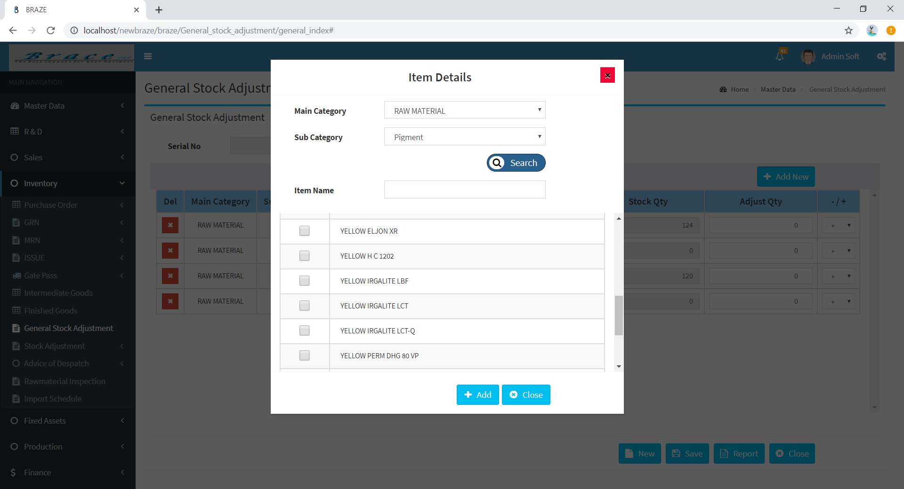
Duties as a Trainee
Task 01
Developed Stock Adjustment for adjust final stocks in end of the year

Slide 5
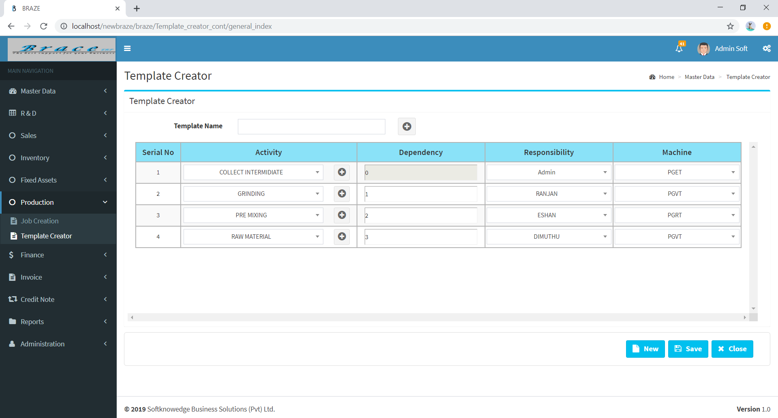
Task 02
Developed a Template creator to create templates based on unique activity

Slide 6
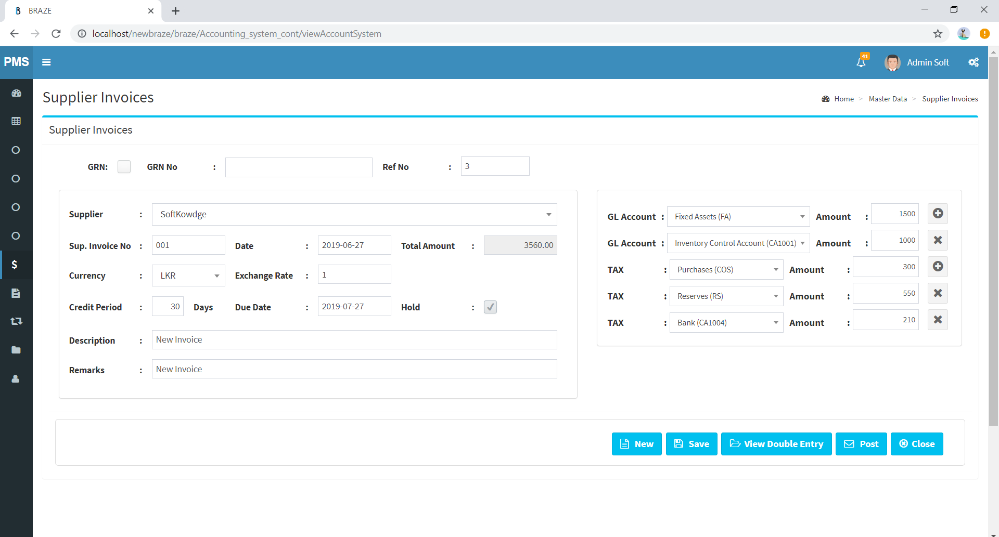
Task 03
Developed UI to save Supplier Invoices in Finance section

Slide 7
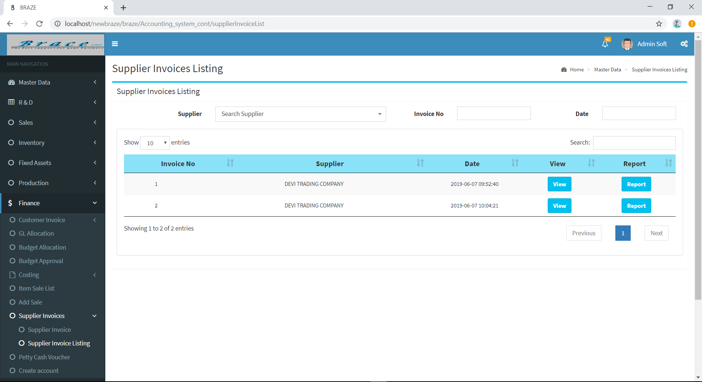
Task 04
Developed Supplier Invoice Listing to get report or update saved invoices

Slide 8
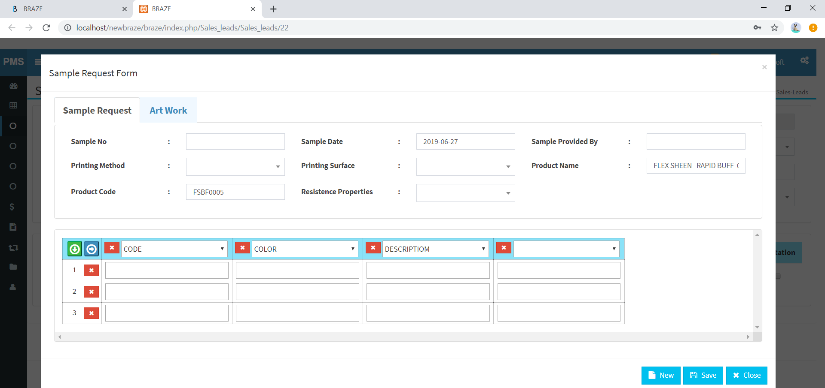
Task 05
Developed Sample Request and Art Work to enter the details about new customer or new product

Slide 9
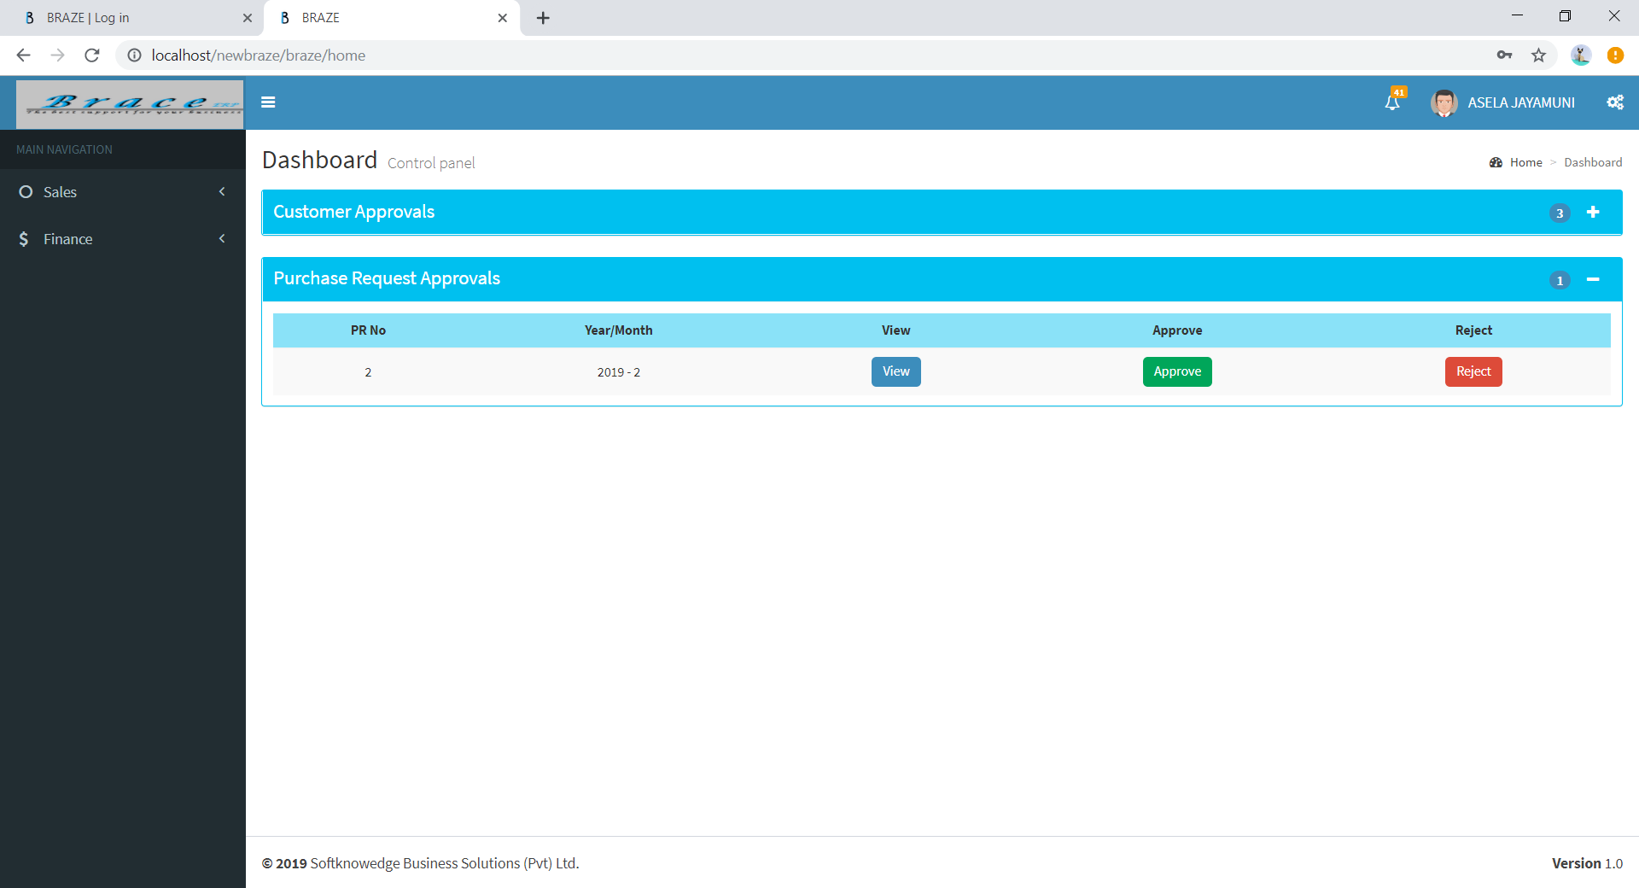
Task 06
Developed Purchase Request Approvals to view, accept and reject purchase request

Slide 10
Conclusion
Get experience about real industrial environment
Get an idea about, what industry expect from employee as undergraduate
The internship is very important to improve future career of undergraduates
Improving ability of how to work together with other employees
Understanding about responsibilities as an employee in the industry

Slide 11
Thank You!

