Slide 1
Wavenet International (Pvt) Ltd
Industrial Training
At
By Chathura K. Jayawardane (2015/CSC/015)

Slide 2
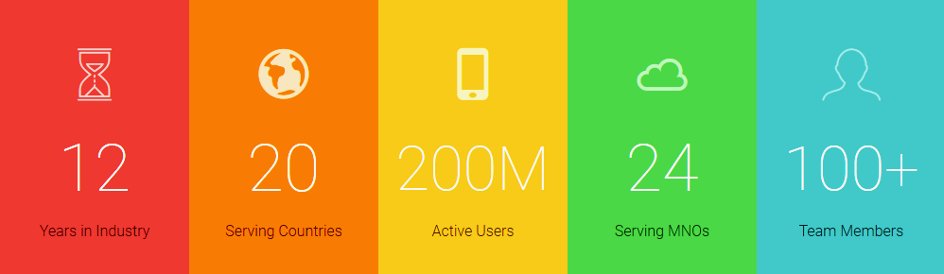
Background Of Company
Vision - To be the customer interaction and value added services partner of choice for global communications service providers.
Mission - Build the enablers that allow carries to simplify, digitize and orchestrate their networks.
Market hold

Slide 3
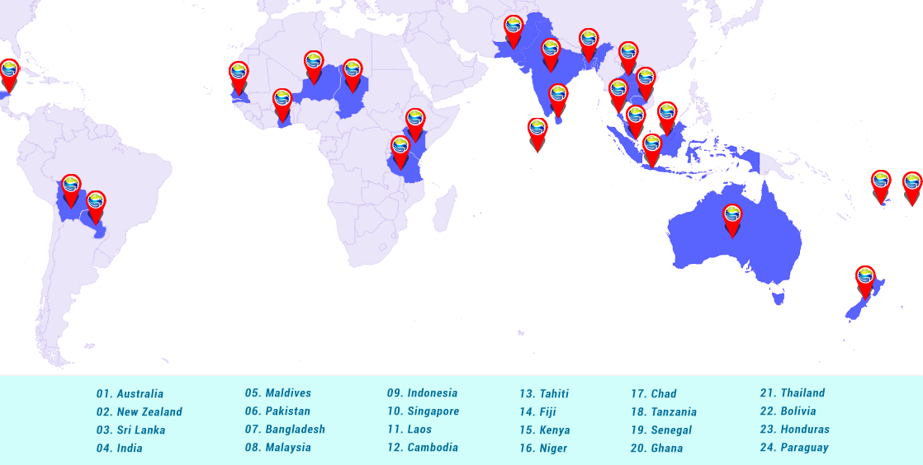
Market hold

Slide 4
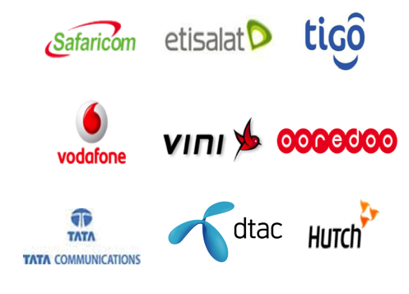
Customers

Slide 5
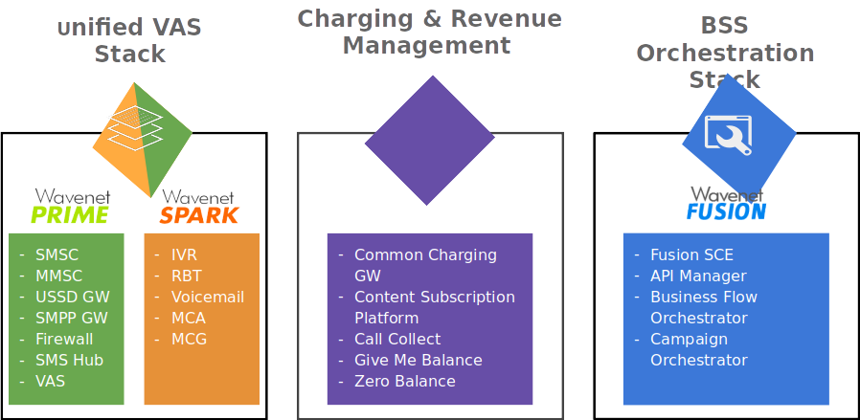
Strategies and Solutions

Slide 6
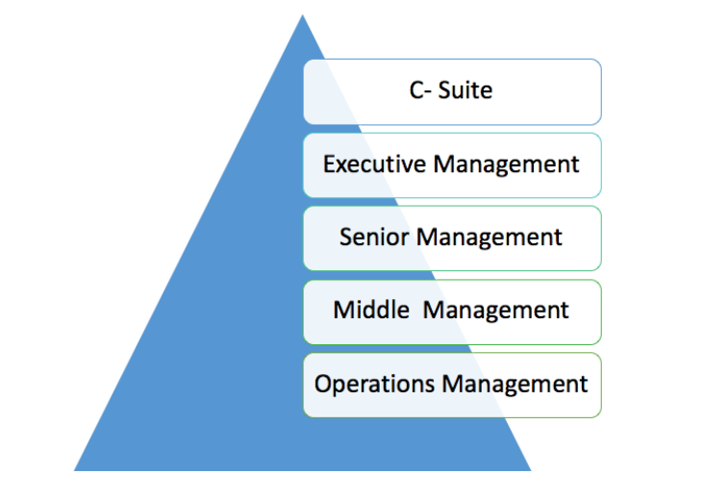
Organization Structure
C - Suite
CEO:
Chief Executive Officer
CFO :
Chief Financial Officer
CCO :
Chief Compliance Officer
CTO :
Chief Technology Officer

Slide 7
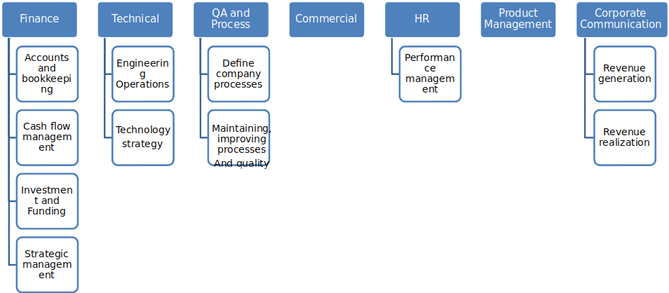
Continue…….

Slide 8







Used Technologies

Slide 9
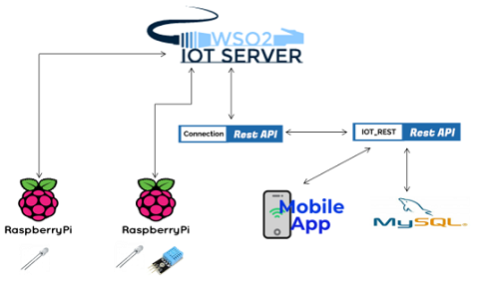
Project

Slide 10
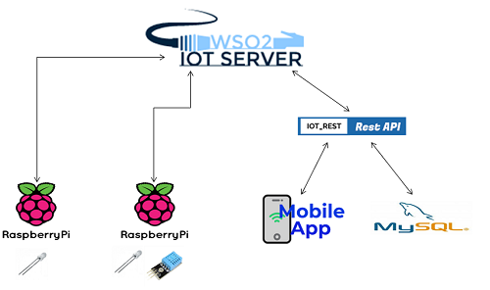
Project

Slide 11
Details of new learning
WSO2 IoT Server
Languages - Erlang, python
Raspberry Pi

Slide 12
Challenges

Slide 13
Q&A

Slide 14
Thank you!

