Slide 1
Industrial Training at
W.W.C.M. Waidyarathna(2015/CSC/012)

Slide 2
About Softknowedge
Softknowedge is an IT Company which was founded in 2010.
Softknowedge specialize in the development of ERP solutions for manufacturing organizations and custom software applications.
Softknowedge carries out custom programming, database design, and client-server and internet/intranet software application development.

Slide 3
Company Services
ERP Implementations
Small Business Application implementations
Customized Software Development
Web site Designing and Development
Mobile Application Development
Business Process Re-Engineering
Software Consultancy
Networking and Communication Solutions
Hardware Solutions

Slide 4
Company Products

Slide 5
Contributed Projects
BRACE web enterprise resource planning solution for manufacturing companies. This solution consists of merchandising inventory management, Planning work study, Production, Sampling, Shipping, Fixed assets management and accounts payable and can integrates to any finance system.

Slide 6
Contributed Projects
RAICE is an integrated solution that helps in managing the most valuable assets in the enterprise that is the employee. This has covered the whole cycle of human resources management starting from recruitment to post resigns. This solution is a fully web based solution.

Slide 7
Technologies
Codeigniter framework
Php
jQuery and Javascript
mysql
html
css
boostrap

Slide 8
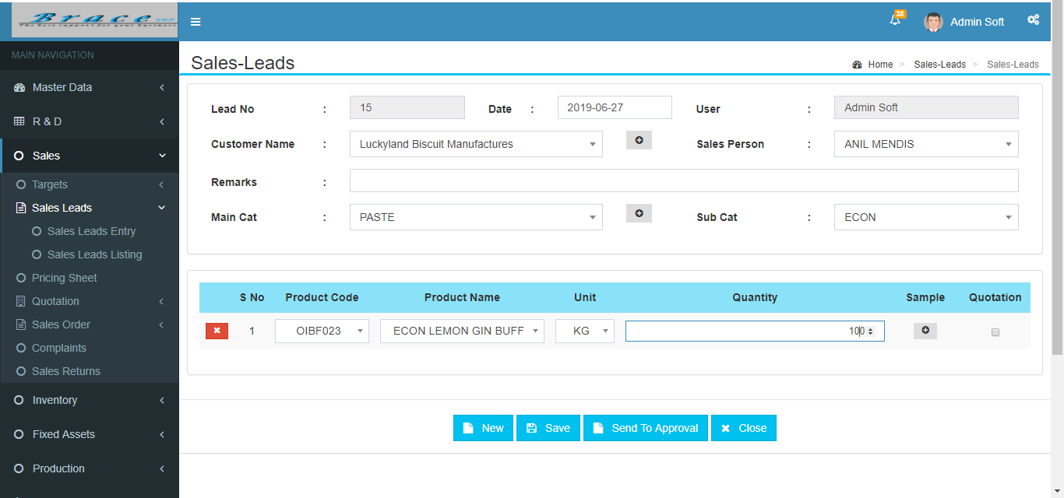
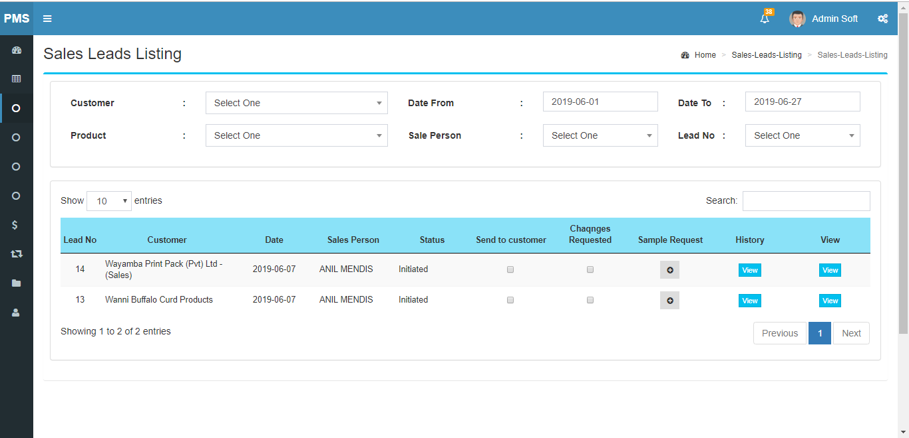
SOME OF MY WORKS
1. Sales Leads.
Sales Leads module has two sections.
Sales Lead Entry
Sales Lead Listing
Using this module user can create, view and edit sales orders for new product.

Slide 9
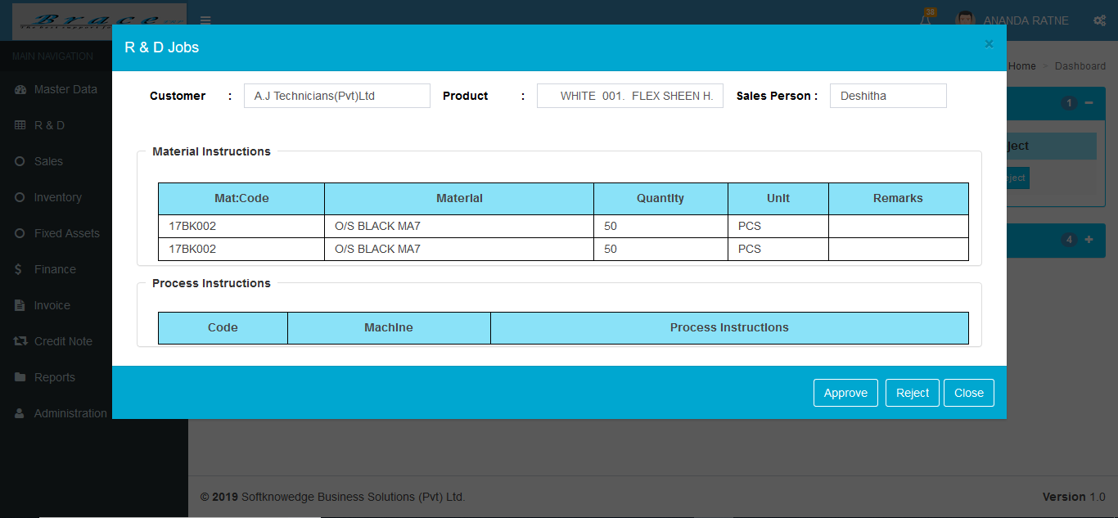
2. R & D Approvals.
This is a dashboard item. Using this module an authorized user can approve or reject requested R & D Jobs.

Slide 10
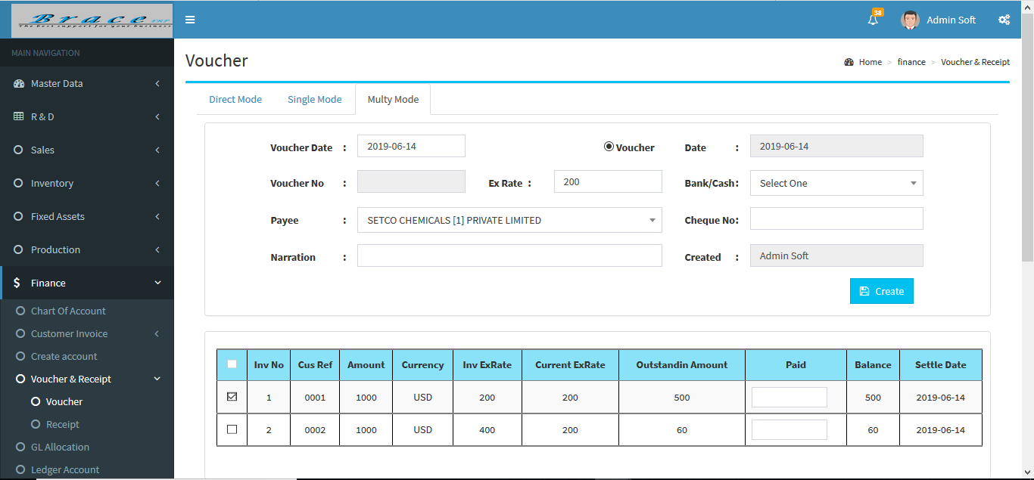
3. Voucher and Receipt
Using this module user can create vouchers and receipts.

Slide 11
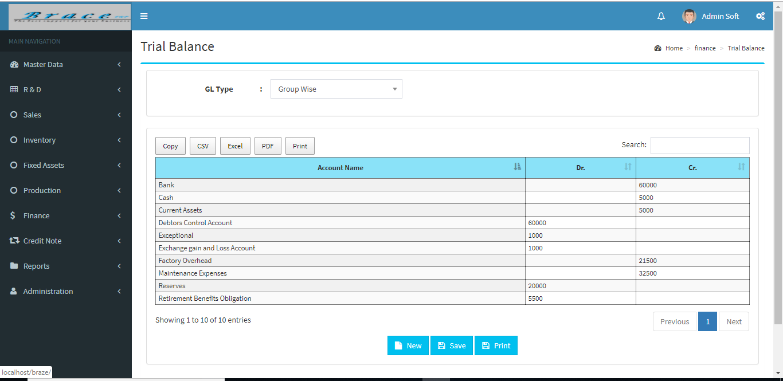
4. Trial Balance
Using this module user can make trial balance report.

Slide 12
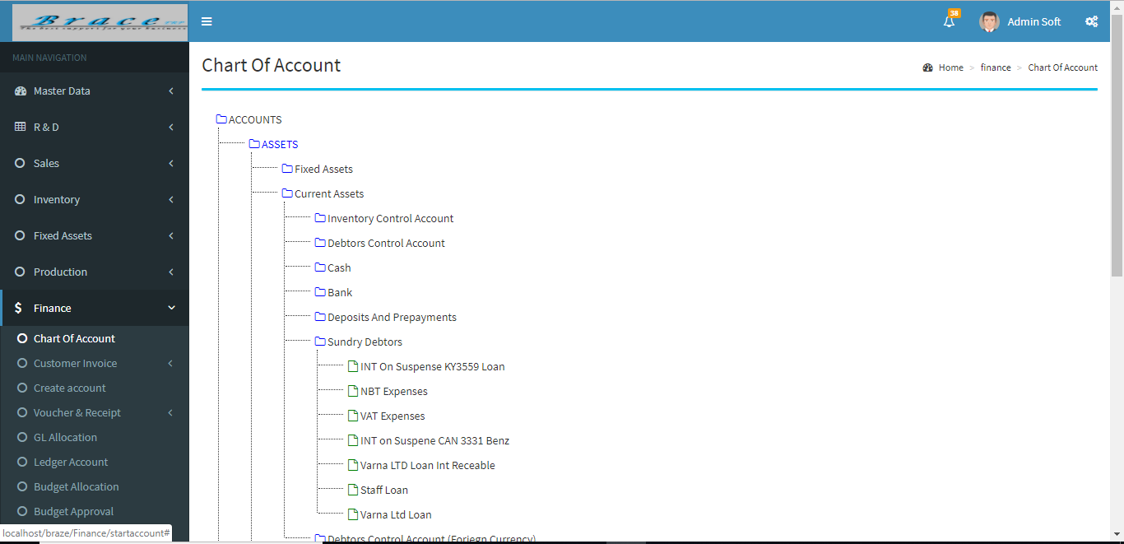
5. Chart Of Accounts
Using this module user can create General Ledger Accounts.

Slide 13
Learning Outcome and Reflection
Improved creativity, critical and logical thinking.
Improved coding skills.
Error checking and handling errors.
Stress tolerance.
Self-management.
Business process understanding.
Team works.

Slide 14
Conclusion
Industrial Training provides an opportunity to an undergraduate to identify, observe and practice how engineering is applicable in the real industrial world.
Practical solving, research and reporting as well as soft skills are improved.

Slide 15
Thank You

