Slide 1
Industrial training at mydynamica
Sampavi sriskandarajah
2015 sp 153

Slide 2
contents
Company profile
Training gained
Learning outcome
Conclusion

Slide 3
introduction
Institute was established in 2010
Its started its function with school project
Institute was registered on 2012.08.24
First project was POS in c# language
They joined in Canadian company in 2016
Mainly focuses in 2 major activities namely product and training the students
Website solution and software solution provider
Vision is recognized as Northern Province’s leading IT solutions company

Slide 4
Products of MyDynamica (Pvt) Ltd
Quicka Online Store (quicka.lk)
MYSCH School Blog (mysch.lk)
Smart School
Coloursweb.site
Red Banana (POS System)
E-Listing (elisting.info)
Yarl CCTV – Security Solution ( CCTV , Fingerprint System, Alarm System, Networking, Intercom, Computer Service & Repairs )

Slide 5
Projects of MyDynamica (Pvt) Ltd
School Management System
ERP Solutions
Institute Management System
Inventory Management System
Hospitality Management System
Exam Management System
Studio Management system
Distribution Management System
Pawing Management System
Restaurant Management System
Hotel Management System
Jewelry Management System
Institute Management System
Textile Management System
Store keeping System
Transport Management System
Printing Management System

Slide 6
Tasks assigned
Data entry of National Institute Of Education Department management, Sri Puttur Somaskanda School management and St John’s college management
Testing of Autolanka system and NIOE
Created Html form for NIOE
Did web designing for V2cc , Saiva paribalana sabhai and Vanikaa medic clinic
Upgraded Quick studio system
Dashboard of Elisting system
Created report and export pdf and excel for Elisting system and Farmers management system
Individual project (Project management system)
Optical System

Slide 7
Project Management system
It is use to assign the tasks for employees
Details about project
Details about client
Get the details about complete task and pending tasks

Slide 8
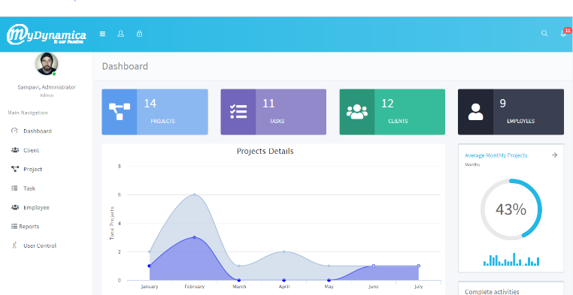

Slide 9
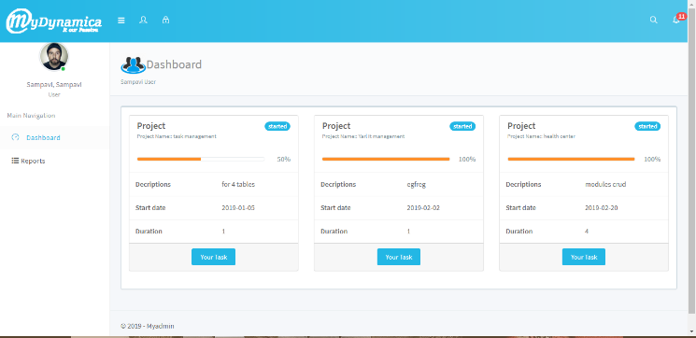

Slide 10
Optical system
This is system for the eye clinic center
Details about patients and their testing results
Channeling

Slide 11
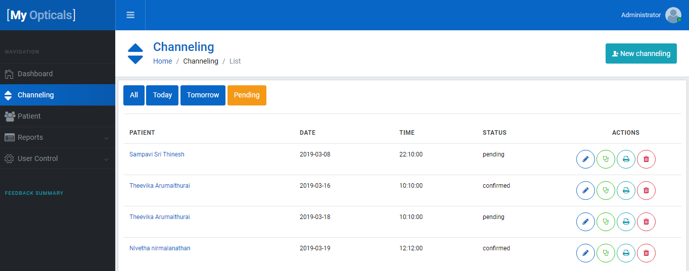

Slide 12
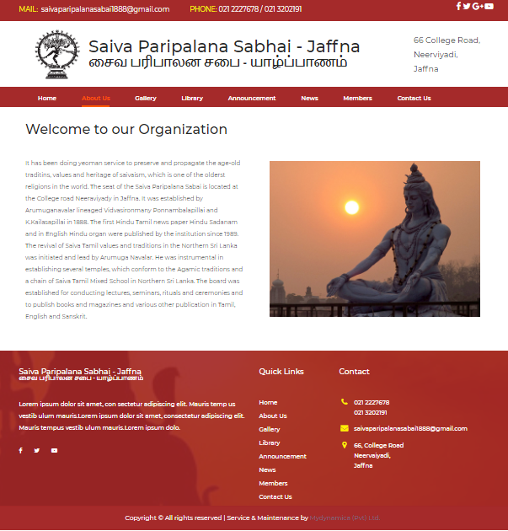
Saiva pariblana sabhai

Slide 13
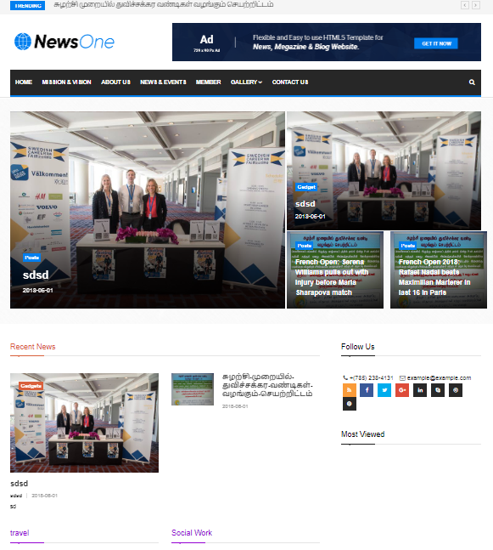
Village to city club

Slide 14

Vanikaa medic clinic

Slide 15








Technologies

Slide 16
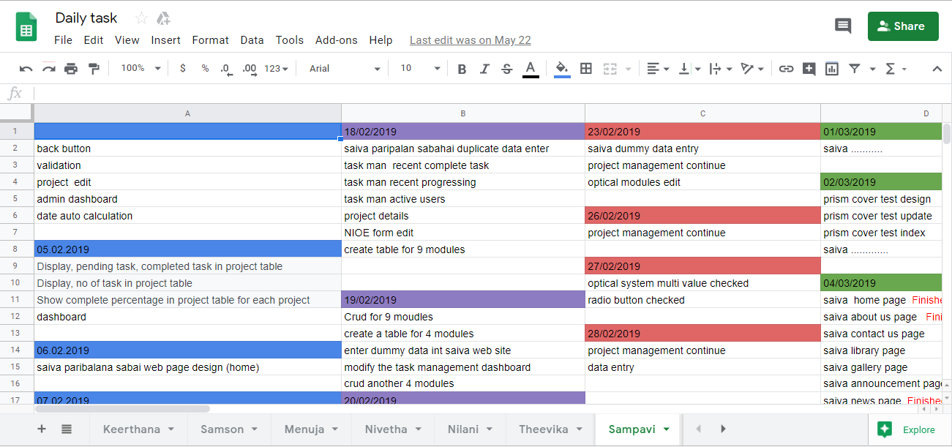
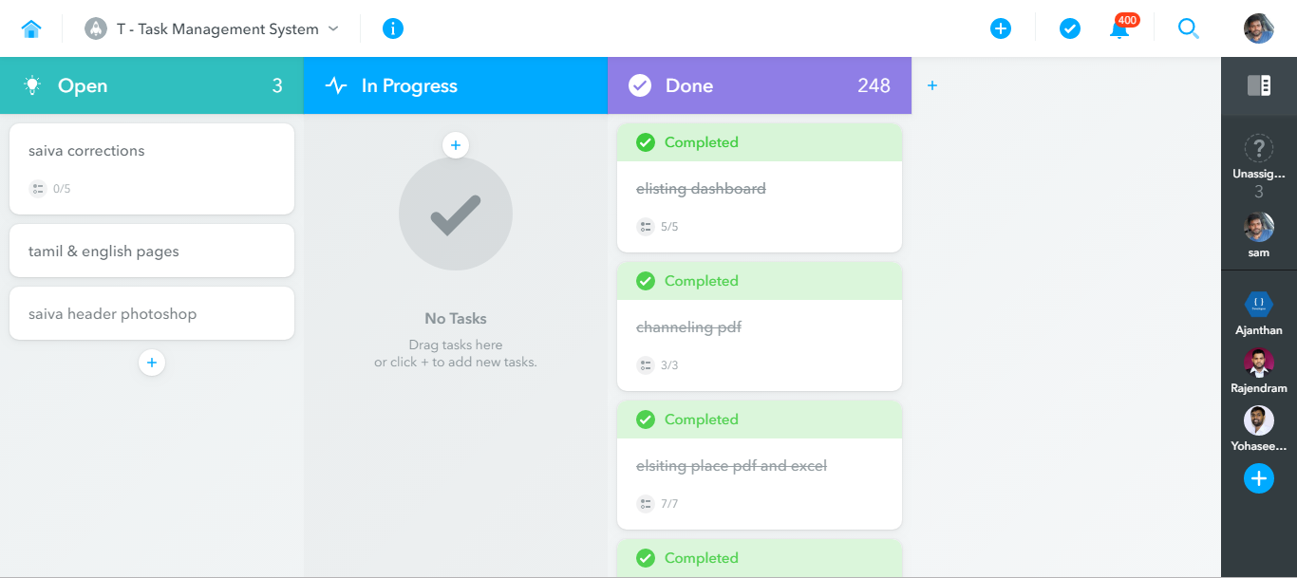
Learning outcome
laravel, php, html, css, bootstraps, ajax and java
Familiar with google sheet and meister task
Virtual hosting
Excel import and export
Pdf conversion
Software testing
UI designing
Database designing
Coding skill
Laravel chart
Self confidence and awareness
Stress tolerance

Slide 17
conclusion
objective of the industrial training is to provide an opportunity to undergraduates to identify, observe and practice how computer science practice is applicable in the real industry.
it would enhance the students’ ability to think, learn independently and solve problems effectively and more importantly.
I could be able to get an awesome training program, which helped to learn a lot of things in all aspects.
I strongly agree on that it would be beneficial to every student to have this type of industrial exposure.

Slide 18
Thank you !

