Slide 1
INDUSTRIAL TRAINING @ OYSLANS SOFTWARE SOLUTIONS(PVT)LTD
MATHEEWS SATHURSHAN
2015 SP 141

Slide 2
COMPANY PROFILE
Oyslans software solutions private limited is one of the reputed company in United Kingdom, India and Srilanka which deals with Point of sale system (POS).
The head office of the company is situated in United Kingdom. They have their branch in Srilanka and India. In Srilanka they have company in Jaffna and Trincomalee.
This is a company which has a great reputation among the countries which it serves. It has an excellent cost-effective solution with market leading all year supported to the petrol forecourt and convenience market.

Slide 3
BRANCHES
Trincomalee Branch situated in
NO.152/4B lower Road Orr’s hill,
Trincomalee.
Jaffna Branch situated in
2nd Floor,
Ramanathan Road,
Infront of the Jaffna university main gate,
Jaffna.

Slide 4
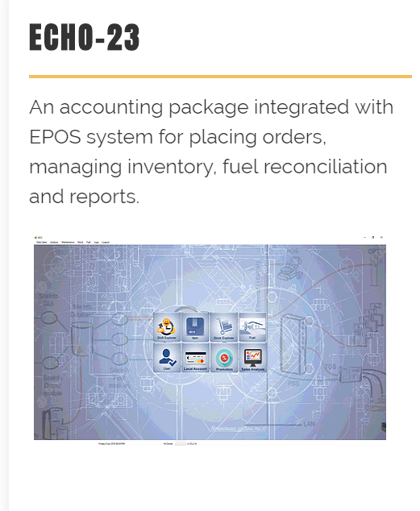
PRODUCTS & SERVICES

Slide 5
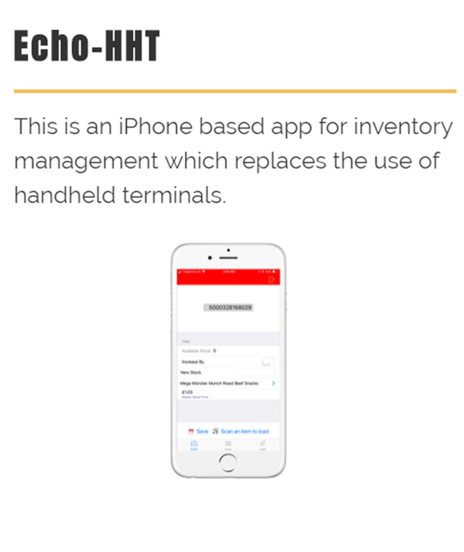
PRODUCTS & SERVICES

Slide 6
TECHNOLOGIES

Slide 7
PARTNERS

Slide 8
CLIENTS

Slide 9
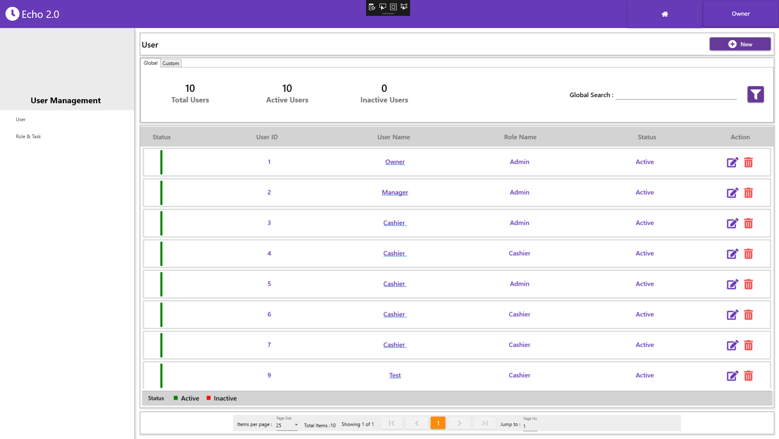
MY WORKS

Slide 10
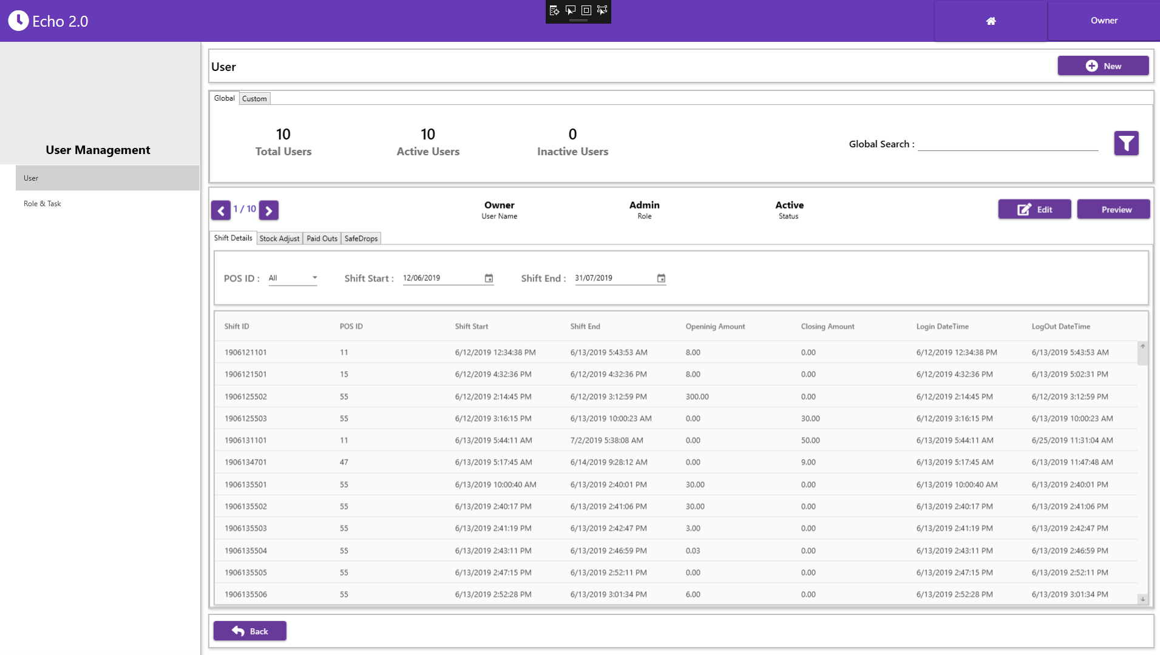

Slide 11
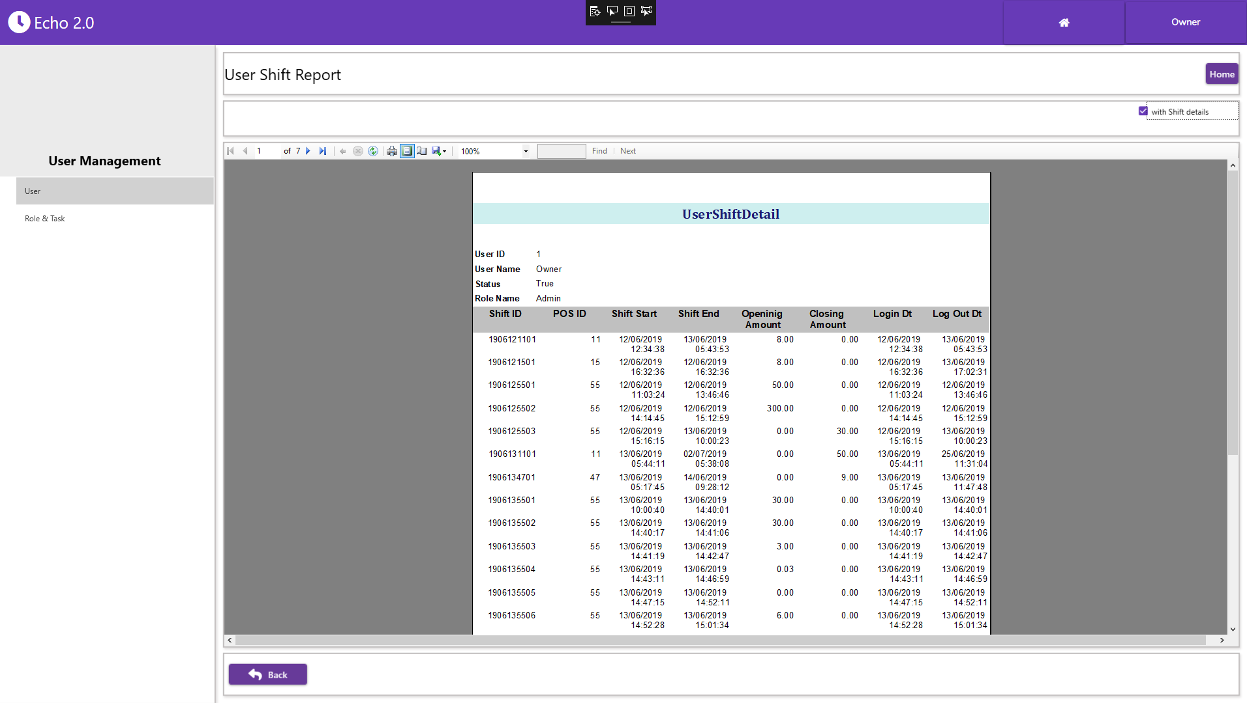

Slide 12
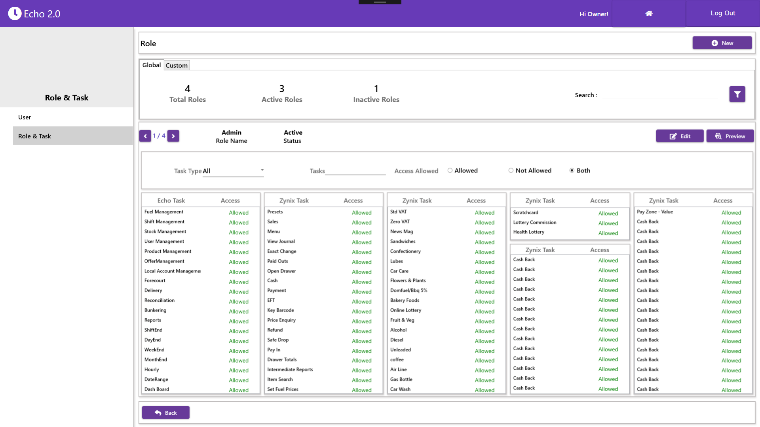

Slide 13
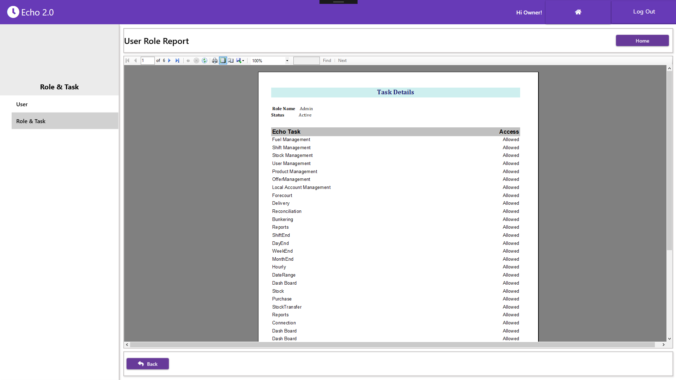

Slide 14
USED & LEARNED TECHNOLOGIES
C Sharp
SQL 2017
NuGet
Entity Framework - 6
Windows Presentation Foundation(WPF)
Material Design-UI
Visual studio Team Foundation Server(TFS)

Slide 15
REFLECTION & LEARNING OUTCOME
Time management
Leadership skills
Communication skills
Problem solving skills
Improved self-motivation
Self learning abilities
Team work

Slide 16
THANK YOU

