Slide 1
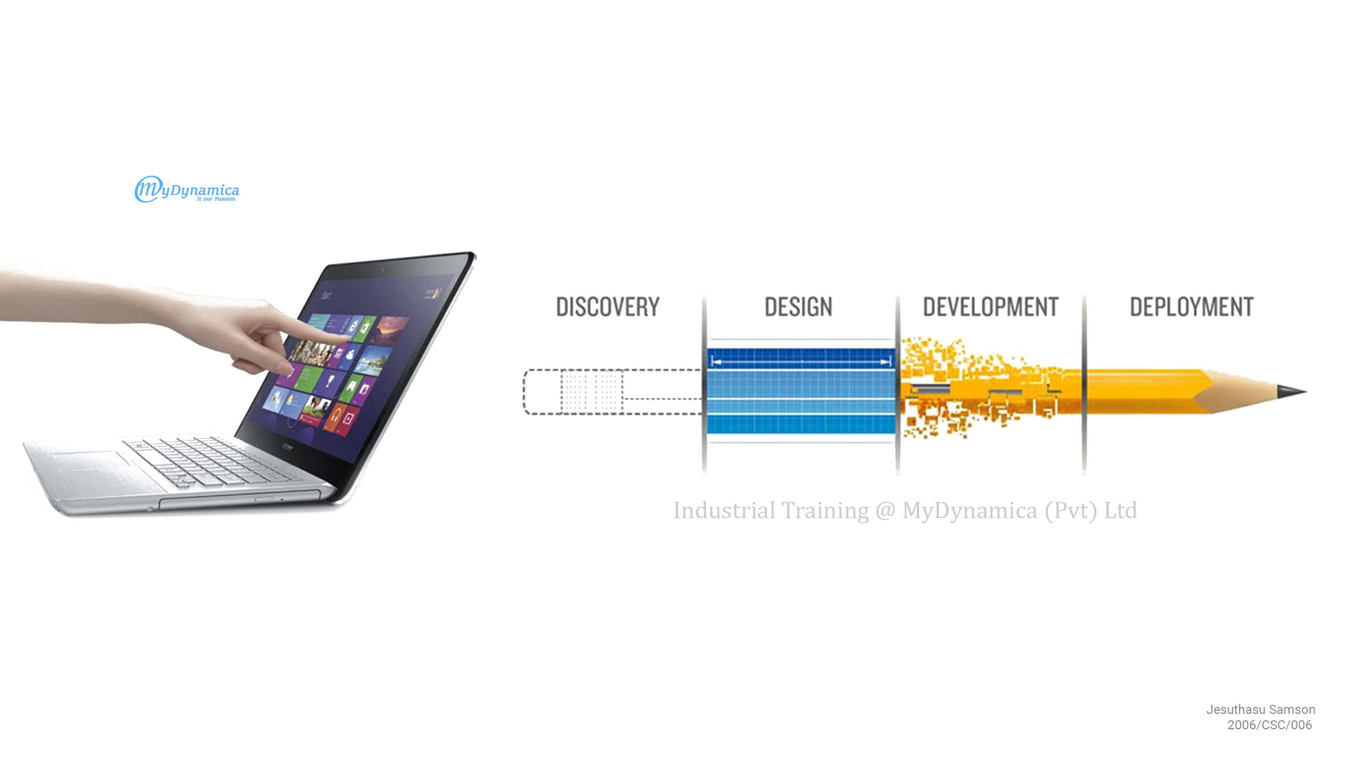

Slide 2

Company Profile
Established in 2010 under the name of “mydynamica.com” by Mr. Yohaseelan and then on 24-08-2012, registered as “MyDynamica (Pvt) Ltd”
Focuses on high standard design, development and delivery of software solutions, installation and maintenance of security system and networking
Providing services:-
    MYSCH School Blog (mysch.lk)
    Smart School System
    CMS
    POS (Red Banana)
    E-Listing (elisting.info)
    Yarl CCTV – Security Solution
    Quicka Online Store (quicka.lk)

Slide 3
My Contribution
Event Organization System (Individual Project)
Employee Management System (Anna Coffee)
Smart Municipal System (Municipality of Jaffna)
National Institute of Education (Data entry)
Quicka Online Store (Data entry with image design)

Slide 4
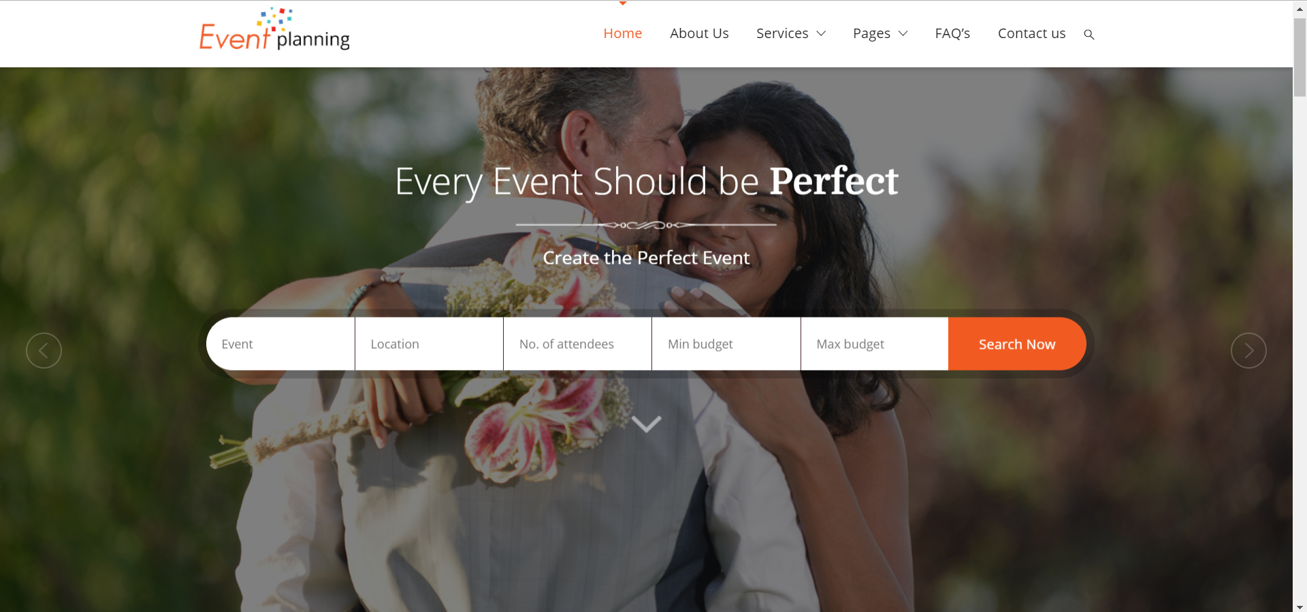
Event Organization System
It is a web-based system developed in Laravel framework to organize events such as birthdays, weddings, etc
Features :-
  Suggests available packages for an event
  Shows the service providers
  Lists the detail of services
  Displays all the customers’ review

Slide 5
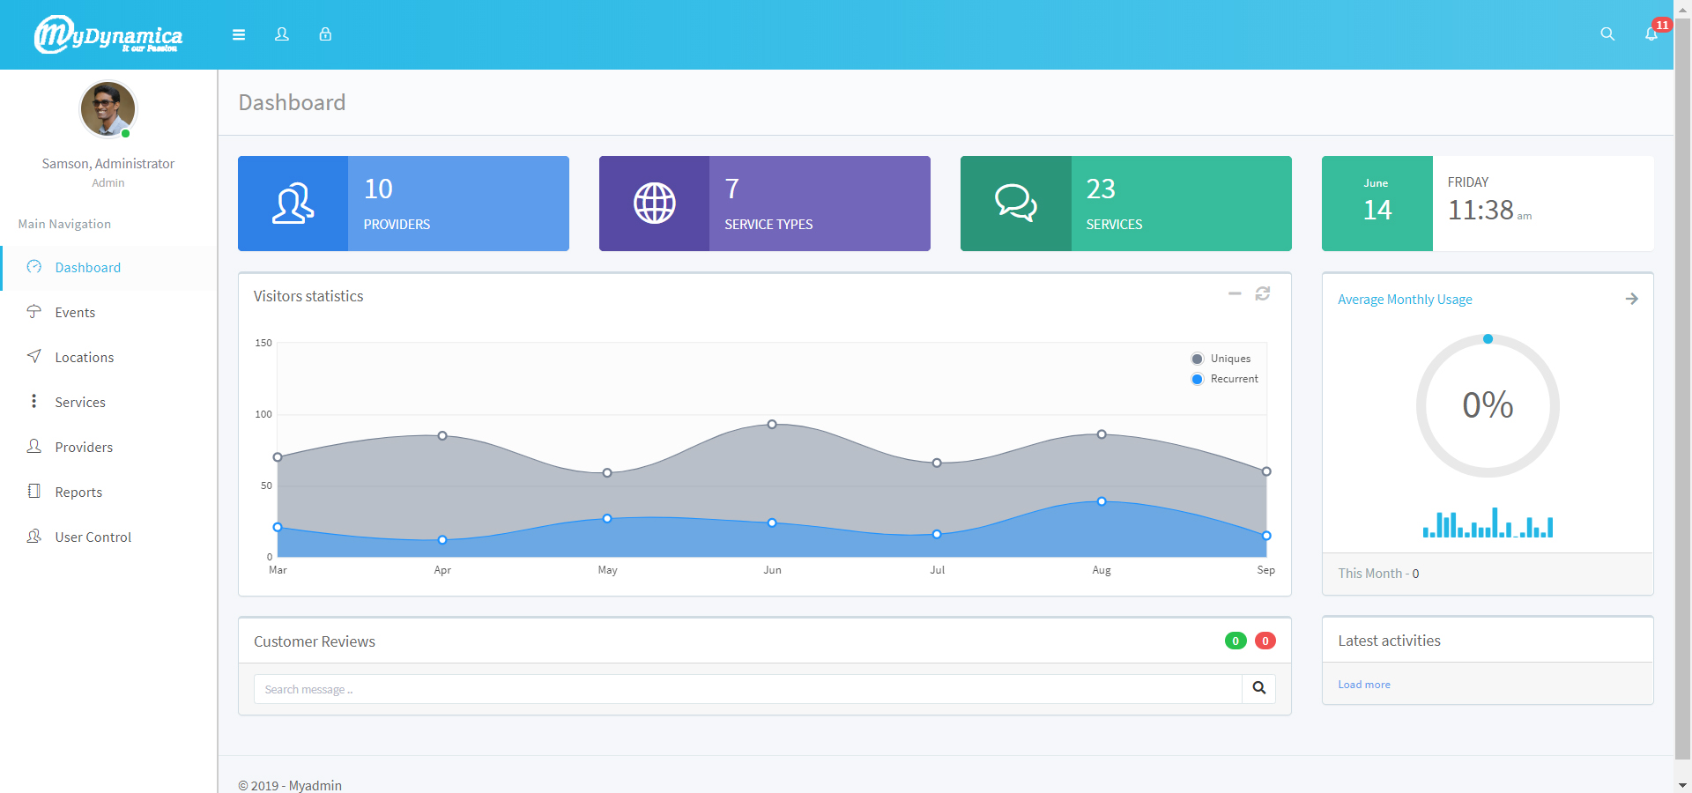
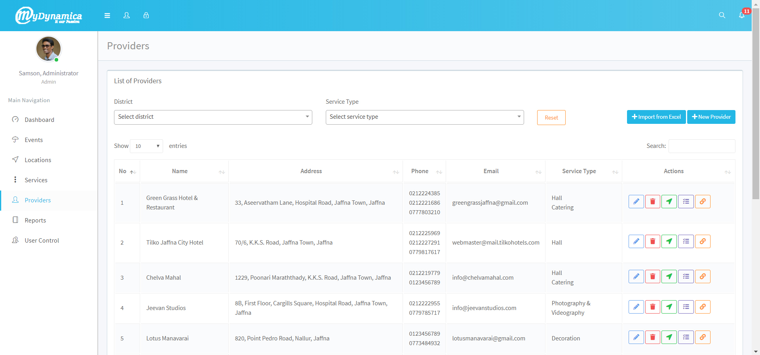
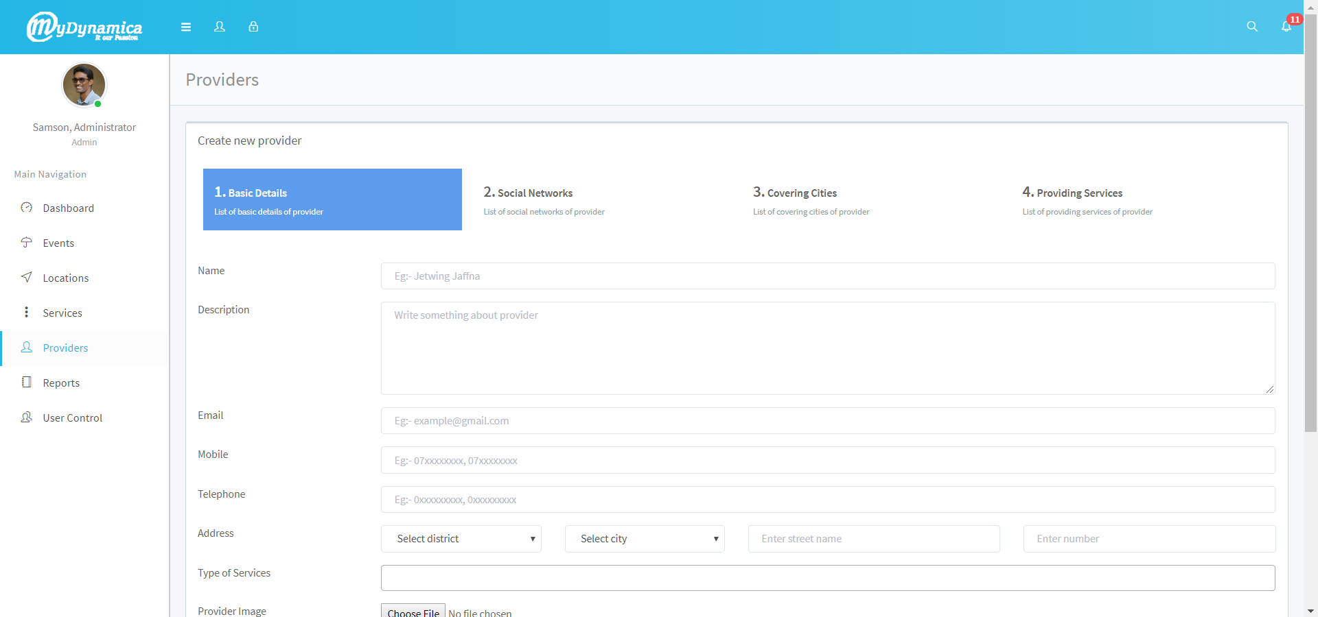
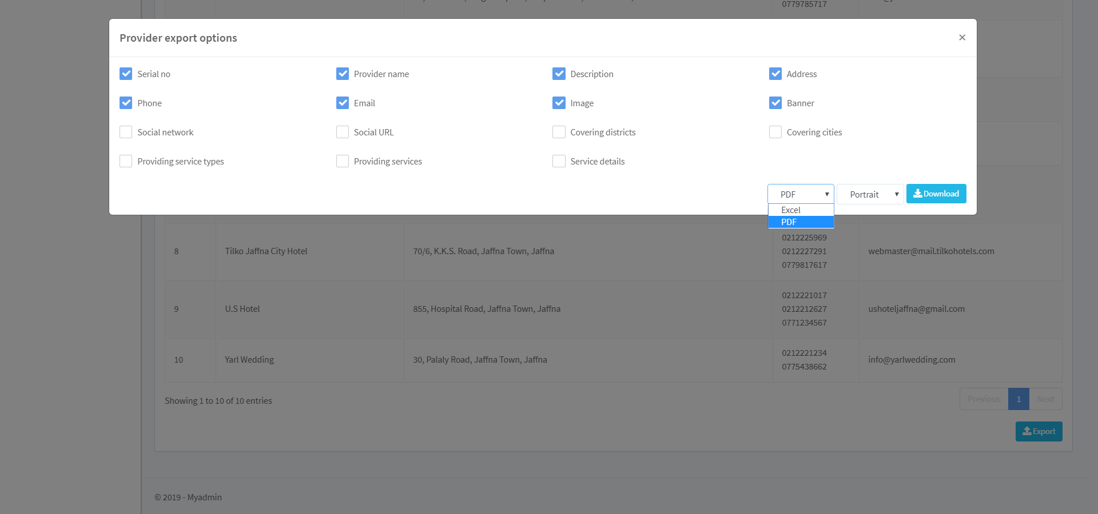
Dashboard
Provider Index
Provider Create
Provider Report

Slide 6
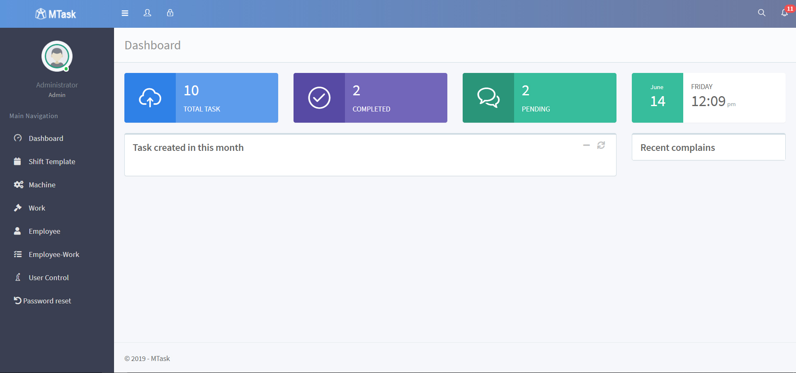
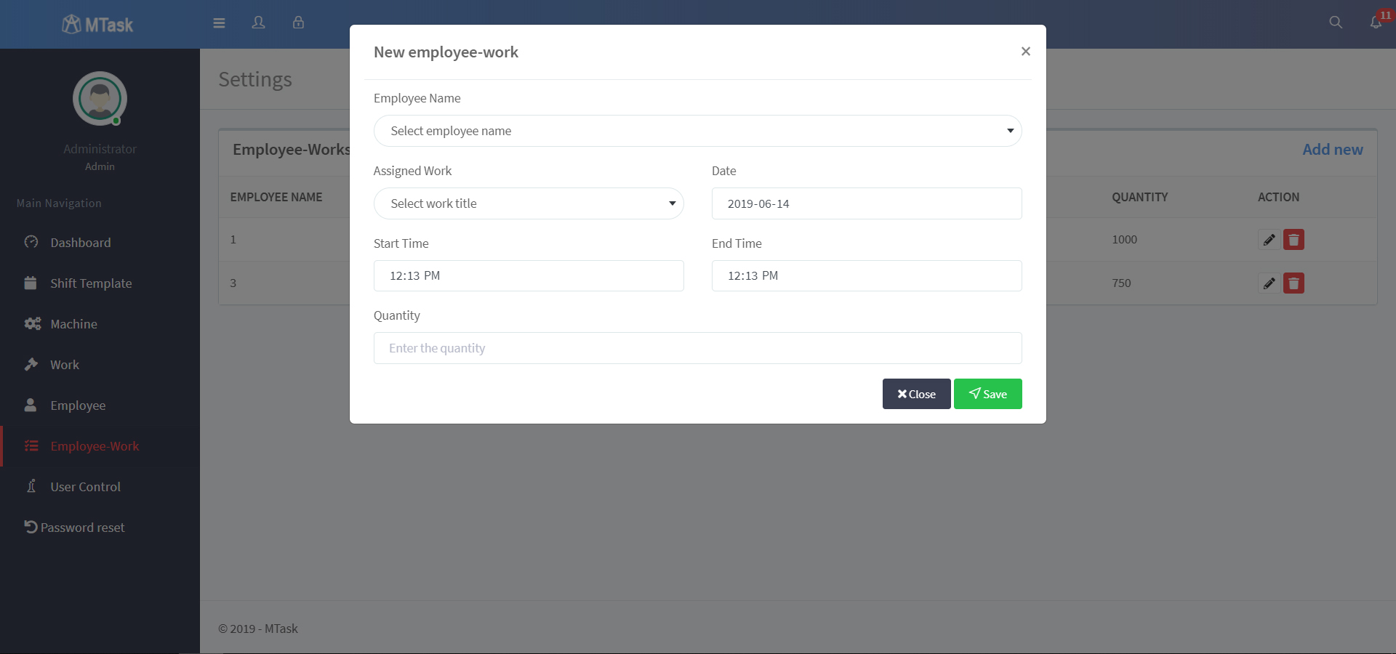
Employee Management System
For the employee management system of Anna Coffee, I completed CRUD for the modules; machine, work, employee, and employee-work

Slide 7
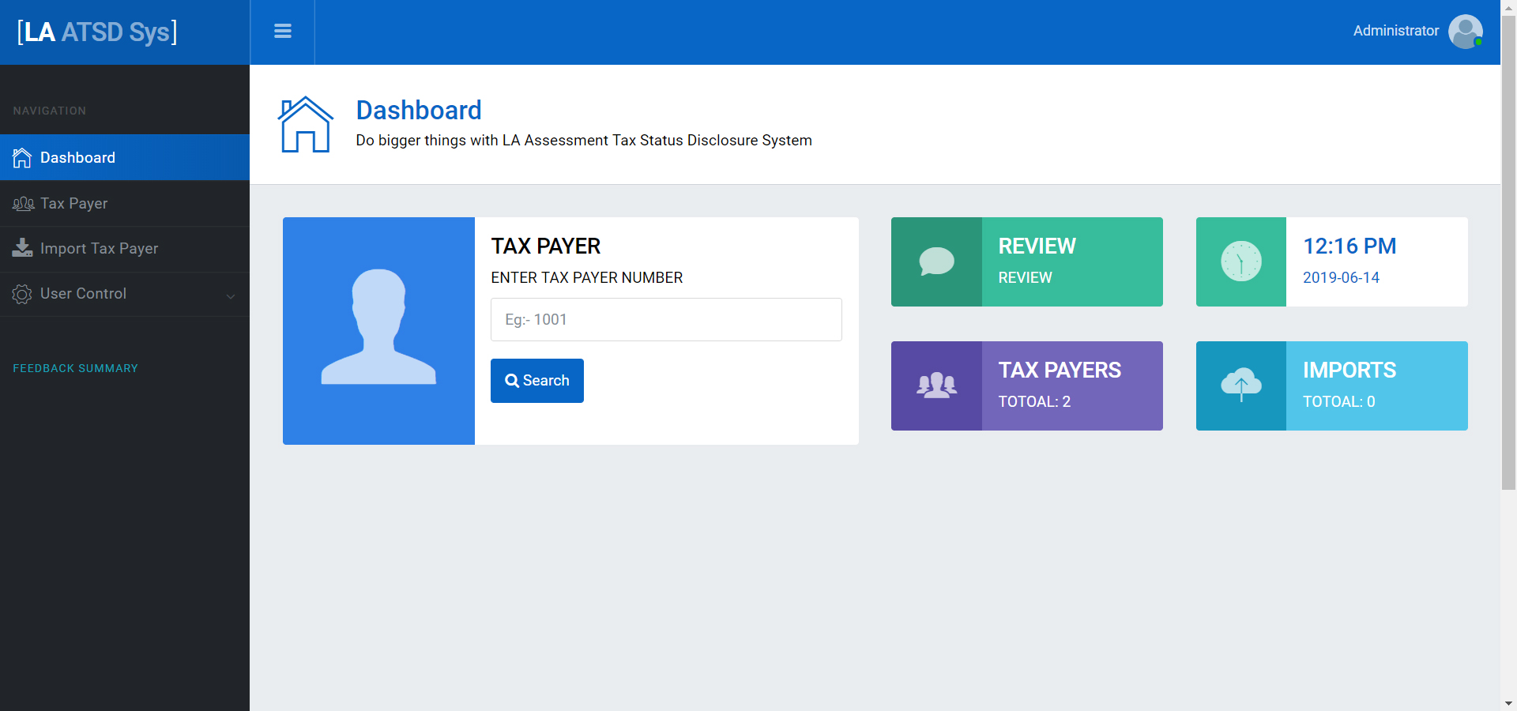
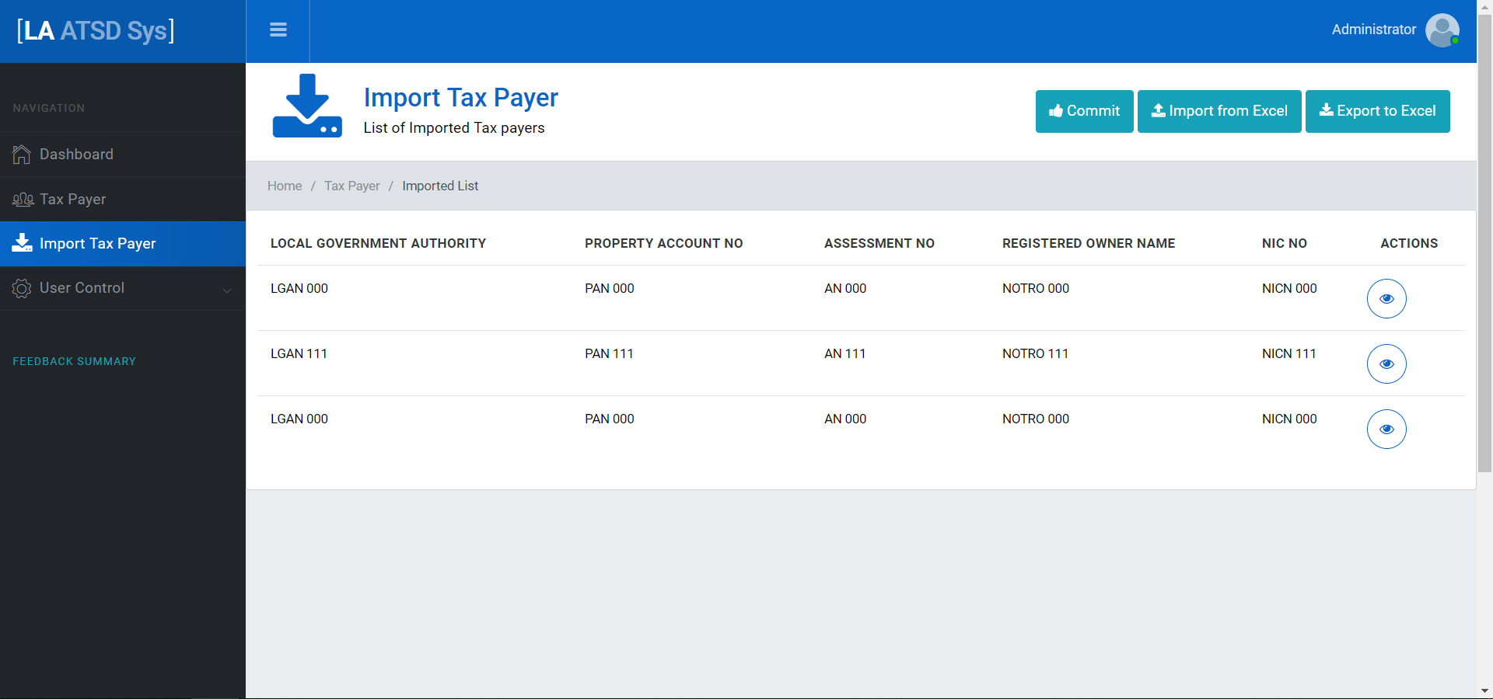
Smart Municipal System
For the Smart Municipal System of municipal council, Jaffna, I did CRUD, excel import and export for taxpayers. Also I created a functionality to commit data from imported-taxpayers to existing taxpayers

Slide 8
Technologies
HTML
CSS
Bootstrap
JavaScript
jQuery
AJAX
PHP
Laravel
MySQL
Java

Slide 9
Learning Outcome
Hands-on with some latest technologies
Self-confidence
Time management
Communication skill
Problem solving skill
Self learning abilities

Slide 10
Thank You!

