Slide 1
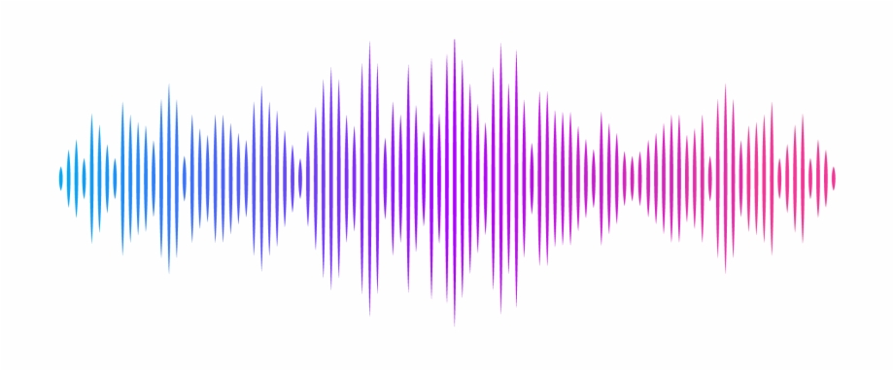
Vocal Trainer
Trains you to sing a desired song
Research by
M. V. Dilanson
2015/CSC/036
Supervisor
Dr. E. Y. A. Charles

Slide 2
The system I wished to achieve..
The user can input a song.
The vocals will be separated and the features of the vocals will be extracted.
Then the user can sing along with the song which is played in the system.
The user will be notified with the flaws he/she make.
A visual (Graphical) representation will be shown in the screen to match both vocals. (Original and the User’s)
The final analysis will be shown to the user according to the singing.

Slide 3
Things that have been achieved by others so far..
Singing rating
Pitch
Modulation
Timing (Beat)
Lyric pronunciation
Falsetto/Vocal effort
Octave change
Cheat detection
Vocal Analysis
Real time graphical representation.
Rule based scoring.
Voice Suppression
Mixing

Slide 4
Technologies used for certain tasks
Singing voice detection module is trained using Support Vector Machine (SVM) classifier.
The features of the singing vocals are extracted using Harmonic Sinusoidal Modeling.
Pitch Contour Representation (PCR) is used for scoring for singing.
Hidden Markov Model (HMM) is used for feature extraction.

Slide 5
The aspects lacking accuracy and fulfilment.
Voice separation is still not perfectly achieved.
Feature extraction is being done every 10ms only. It can be made lesser.
There are possibilities to achieve the tasks using Deep Learning but it is not done yet.

Slide 6
Related References
Singing Voice Separation using Adaptive Window Harmonic Sinusoidal Modeling - MIREX 2014
By Preeti Rao, Nagesh Nayak, and Sharath Adavanne
Singing pitch extraction from monaural polyphonic songs by contextual audio modeling and singing harmonic enhancement – ISMIR 2009
By Chao-Ling Hsu, Liang-Yu Chen, Jyh-Shing Roger Jang, Hsing-Ji Li
A hierarchical approach for music chord modeling based on the analysis of tonal characteristics
By Namunu C. Maddage, Mohan S. Kankanhalli, Haizhou Li
Sensibol.com | Sensibol Audio Technologies Pvt. Ltd.

Slide 7
THANK YOU

