Slide 1
Research Proposal : CSC416SC6
A personal persistent backup/restore architecture using opportunistic networks
Supervisor: Dr. K. Thabotharan
Bhagya Udayangani
2015/CSC/016
Department of Computer Science
University of Jaffna
September 20, 2019

Slide 2
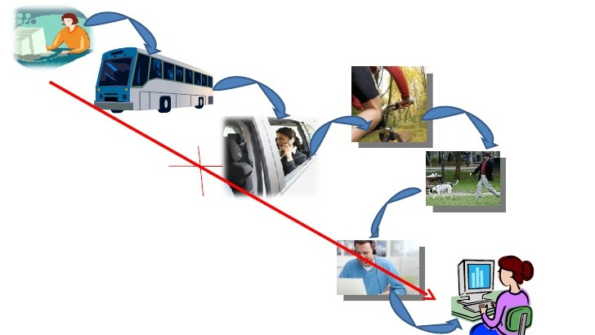
Introduction

Slide 3
Research Goal & Objectives
Many studies on opportunistic routing, self-similarity content distribution to be done.
The goal of my study is to develop a new routing protocol for opportunistic networks to perform a persistent backup and restore of personal data between two directly connected hosts.

Slide 4
Challenges
Studying the concept of a persistent storage, self-similarity property of opportunistic networks.
Learning about ONE simulator.

Slide 5
Application
Now we use cloud storage to backup/restore process. But an internet connection is needed for that. But we do not have an internet connection at every time. With the concept of opportunistic networks users are able to backup/restore their data in other devices storage opportunistically.

Slide 6
Related Works
Author | Description | Topics
Chathura Weerasooriya Dr. Nalin Ranasinghe | They use based implementations for such storage in mobile ad-hoc networks. They provided a mechanism to reduce read/write time, reducing the size of the quorum. | Opportunistic persistent data storage.
Luciana Pelusi Andrea Passarella Marco Conti | They survey the most interesting case studies related to opportunistic networking and discuss and organize a taxonomy for the main routing and forwarding approaches. | Opportunistic Networking: Data forwarding in Disconnected Mobile Ad-hoc Networks.
Dr. K. Thabotharan Dr. Nalin Ranasinghe | They use statistical estimators to show that the opportunistic network connectivity traces possess the self similarity property and therefore are capable of predicting future contact opportunities using the past history. | Self-similarity And Predictability of contact opportunities in ONs.

Slide 7
References
N. R. Thabotharan Kathiravelu, "Self similarity and predictability of contact opportunities in Opportunistic Networks," in Networks (ICON), 2012 18th IEEE International Conference, Singapore, 2012.
A. P. a. M. C. Luciana Pelusi, "Opportunistic networking:Data Forwarding in Disconnected Mobile Ad hoc Networks," IEEE Communications Magazine, 2006.
C. Weerasooriya and D.N. Ranasinghe, "Opportunistic Persistent Data Storage", Computer, 2016.

Slide 8
Thank you!

