Slide 1
3D Model Reconstruction From 2D Sketch
Name:- Jesuthasu Samson
Reg No:- 2006/CSC/006
Supervisor:- Mr. S. Suthakar

Slide 2
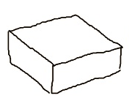
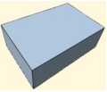
DEFINITION
Problem:- 3D shape reconstruction from 2D freehand sketch for basic solids
Objective:- Develop an artificial intelligence able to emulate cognitive functions
regarding spatial imagination and other capabilities
Despite the imprecision of a freehand sketch, a person could also say that the strokes represent a particular solid (Eg: cuboid), but for a machine, it is a step by step process
Input: a hand-made sketch (2D)
Output: a cuboid (3D)

Slide 3
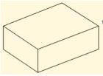
STEPS
Input: a hand-made sketch (2D)
Output: a cuboid (3D)
Transform the irregular strokes into string lines
Extract the required measurements
Obtain the corresponding conceptual geometry after a heuristic interpretation process

Slide 4
RELATED WORKS
A 3D Model Retrieval Method Using 2D Freehand Sketches
Retrieve desired 3D models by measuring the similarity between a user’s freehand sketches and 2D orthogonal views generated from 3D models
3D Shape Reconstruction from Sketches via Multi-view Convolutional Networks
output a dense point cloud representing a 3D reconstruction, convert into a polygon mesh, using encoder-decoder network the multi-view maps are then consolidated into a 3D point cloud
3D Model Retrieval Based on Hand Drawn Sketches Using LDA Model
generate 2D views of 3D models, extract low level features from sketch and 2D views and encode them as visual words, use LDA method to achieve topics distribution

Slide 5
GAP
Only few data related to the 2D polygon are available to match the free hand sketches
Here I will introduce a mathematical method to construct 2D sketches into 3D models without the middle conversion which is to convert free hand sketches to 2D polygon by matching similarity

Slide 6
Thank You

